Slide 1
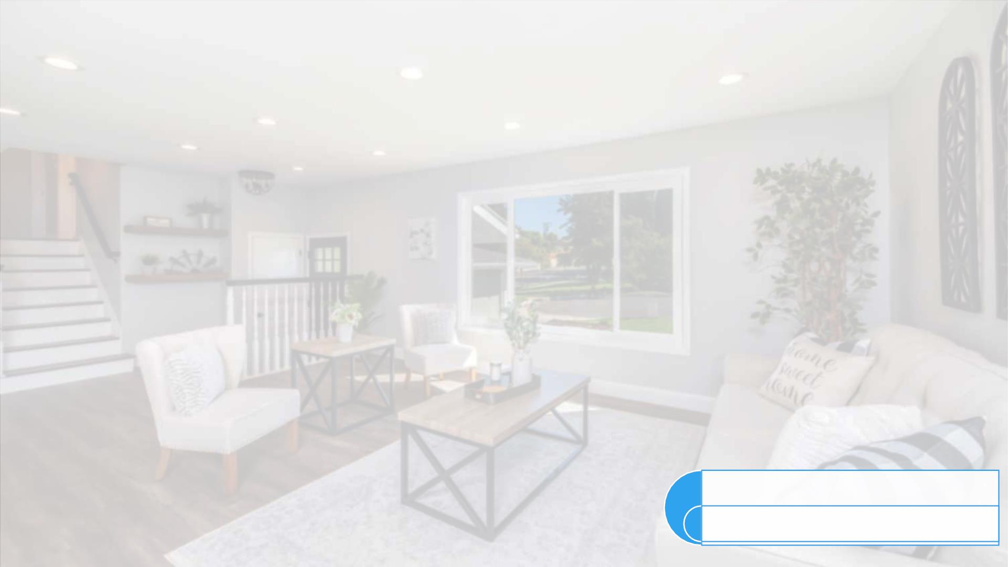
CAPSTONE PROJECT
“SHOP FOR HOME”
GROUP-6
PRESENTED BY:
SAMRIDHI PANDEY
VAMSI KRISHNA LUKKA
AKANKSHA KASHYAP
VENKATESH MAHANTI
SUDEEP SHERIKAR
MENTOR
MR. PARTH SHUKLA

Slide 2

INTRODUCTION
• ONLINE SHOPPINGꢀISꢀ THEꢀ ACTIVITYꢀ ORꢀ ACTIONꢀ OFꢀ BUYINGꢀ
PRODUCTSꢀ ORꢀ SERVICESꢀ OVERꢀ THEꢀ INTERNET.ꢀ ITꢀ MEANSꢀ GOINGꢀ
ONLINE,ꢀ LANDINGꢀ ONꢀ Aꢀ SELLER’Sꢀ WEBSITE,ꢀ SELECTINGꢀ SOMETHING,ꢀ
ANDꢀ ARRANGINGꢀ FORꢀ ITSꢀ DELIVERY.ꢀTHEꢀ BUYERꢀ EITHERꢀ PAYSꢀFORꢀ
THEꢀ GOODꢀ ORꢀ SERVICEꢀ ONLINEꢀ WITHꢀ Aꢀ CREDITꢀ ORꢀ DEBITꢀ CARDꢀ ORꢀ
UPONꢀDELIVERY.
• ASꢀPEOPLEꢀEMBRACEDꢀ SOCIALꢀ DISTANCING,ꢀ THEYꢀ TURNEDꢀ
TOꢀONLINE SHOPPINGꢀMOREꢀ THANꢀ EVERꢀ BEFORE.ꢀ 67%ꢀ OFꢀ
CONSUMERSꢀREPORTꢀTHEYꢀSHOPꢀDIFFERENTLYꢀNOWꢀDUE TO COVID-
19.
• SHOPFORHOMEꢀISꢀAꢀPOPULARꢀSTOREꢀINꢀTHEꢀMARKETꢀFORꢀSHOPPINGꢀ
THEꢀ HOMEꢀ DÉCORꢀ STUFF.ꢀ DUEꢀ TOꢀ COVIDꢀ 19ꢀ ALLꢀ THEꢀ OFFLINEꢀ
SHOPPINGꢀ STOPPED.ꢀ SO,ꢀ THEꢀ STOREꢀ WANTSꢀ TOꢀ MOVEꢀ TOꢀ THEꢀ
CLOUDꢀPLATFORMSꢀANDꢀWANTSꢀTHEIRꢀOWNꢀWEBꢀAPPLICATION.

Slide 3

OBJECTIVES
• OBJECTIVE OF PROJECT
❑ TOꢀGAINꢀTHEꢀINDUSTRIALꢀKNOWLEDGE
❑ TOꢀACQUIREꢀSKILLSꢀREQUIREDꢀTOꢀBUILDꢀTHEꢀREALꢀTIMEꢀPROJECTS
❑ TOꢀ GETꢀ HANDS-ONꢀ TRAININGꢀ BYꢀ SOLVINGꢀ ASSIGNMENTS
❑ TOꢀ GETꢀ INDUSTRYꢀ READYꢀ BYꢀ SOLVINGꢀ THEꢀ CHALLENGES

Slide 4

TECHNOLOGIES USED
• SPRING BOOT 2.7
• ANGULAR 14
• MYSQL 8
• BOOTSTRAP 5
• BOOTSTRAP-ICONS
• EUREKA SERVER
• SPRING CLOUD CONFIG SERVER
• SPRING SECURITY

Slide 5

OVERVIEW OF DATABASE

Slide 6
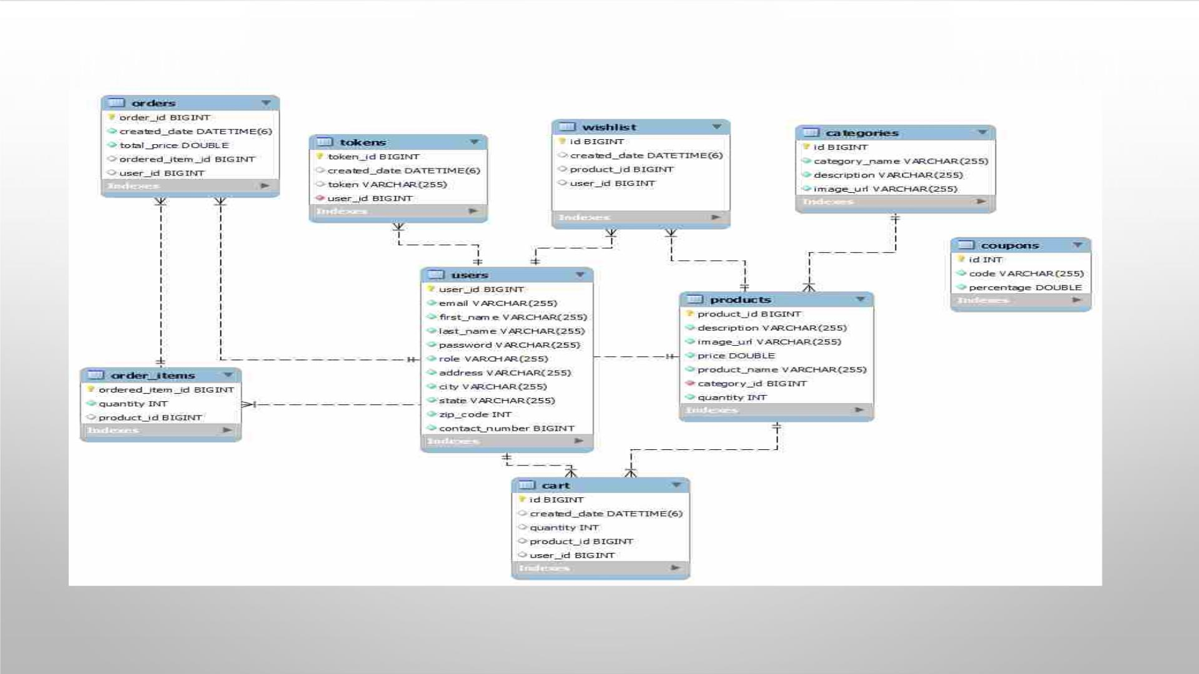
ER DIAGRAM

Slide 7

MYSQL TABLES

Slide 8
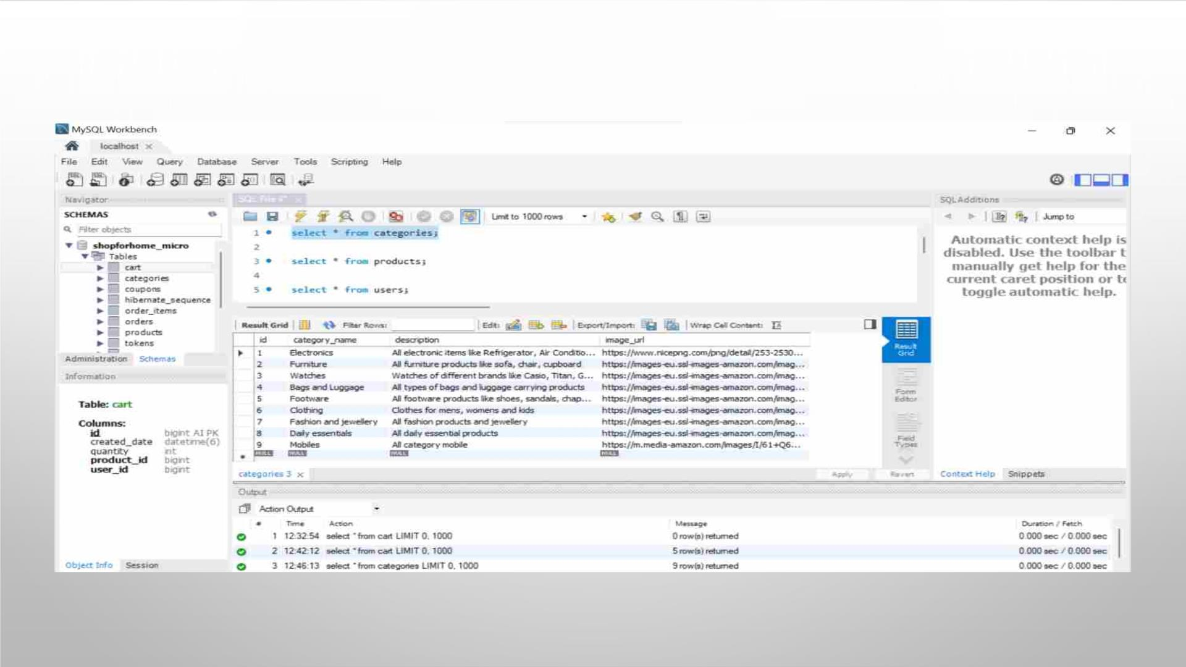
CATEGORIESꢀTABLE

Slide 9
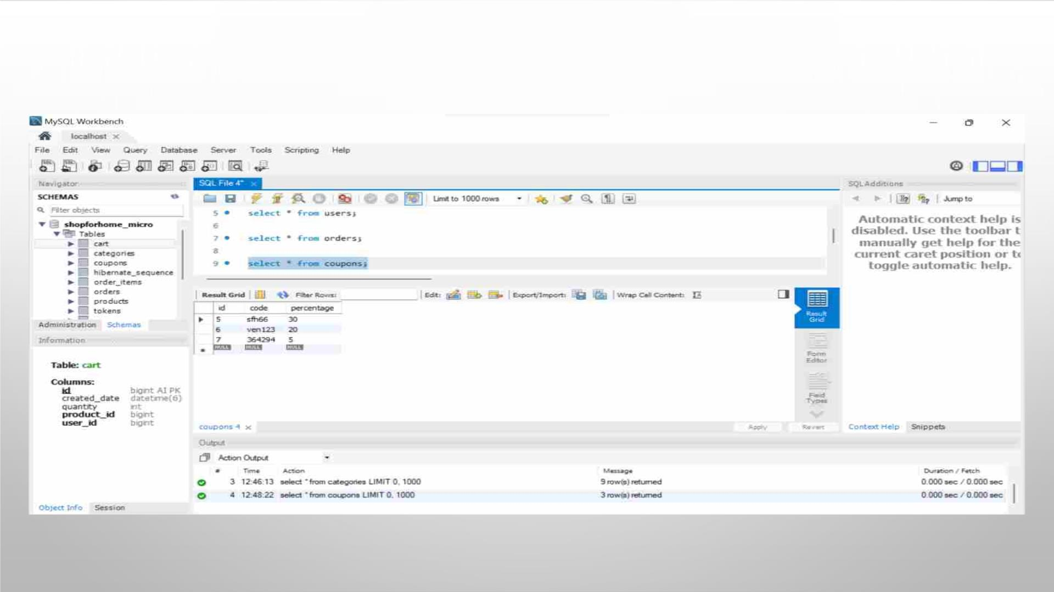
COUPONS TABLE

Slide 10
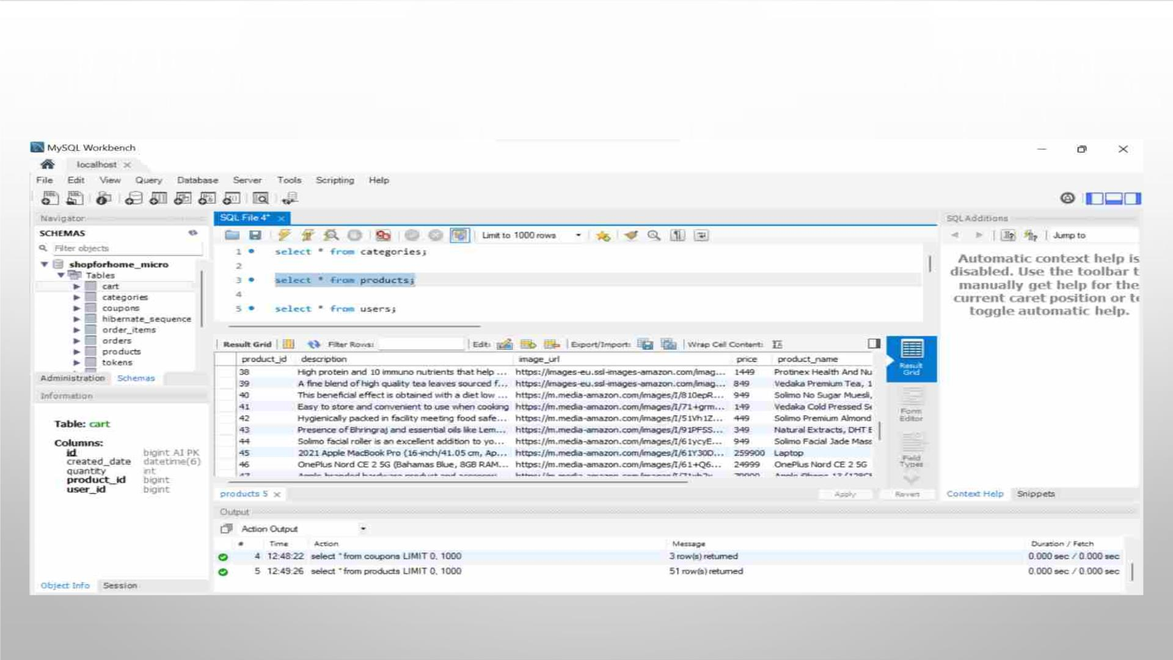
PRODUCTS TABLE

Slide 11
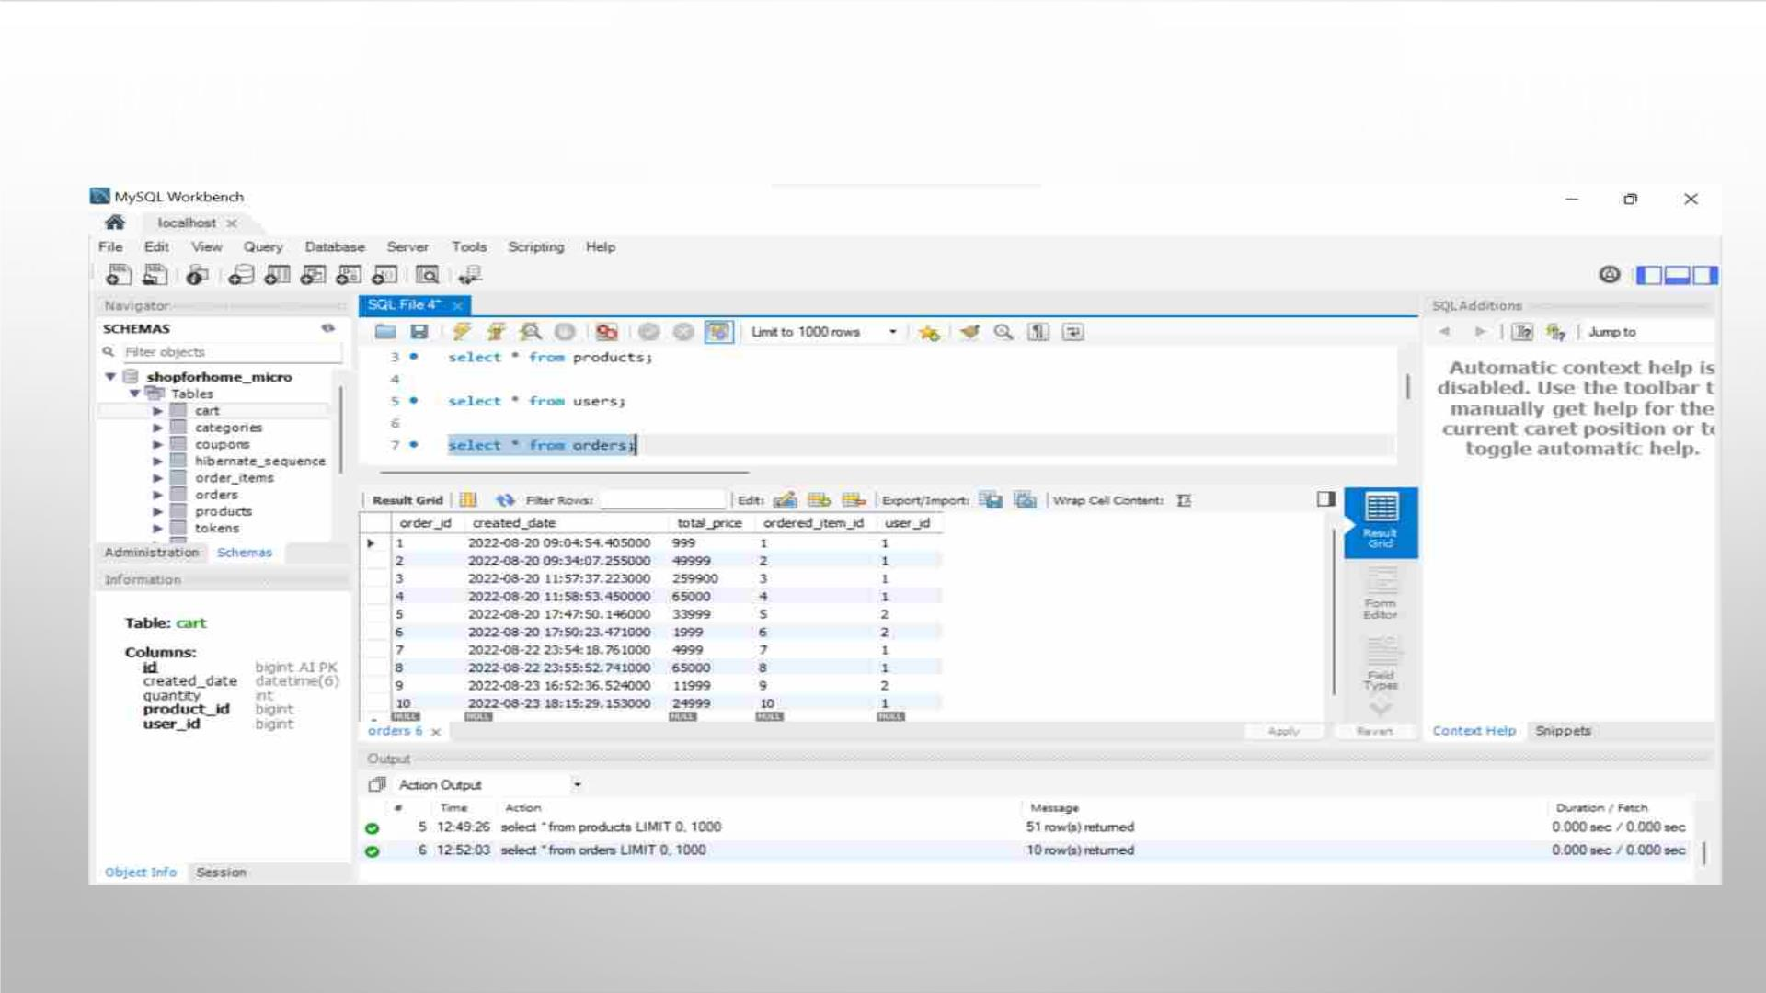
ORDERS TABLE

Slide 12
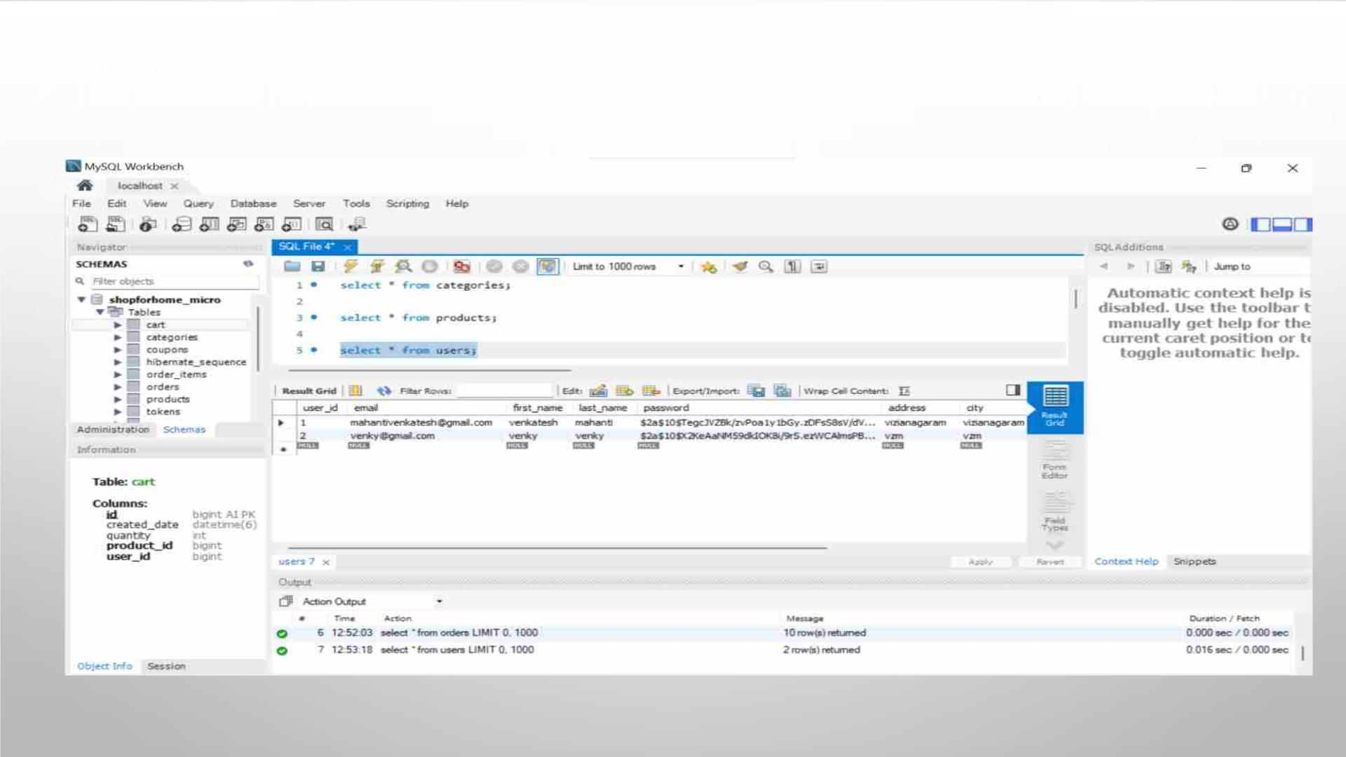
USERS TABLE

Slide 13
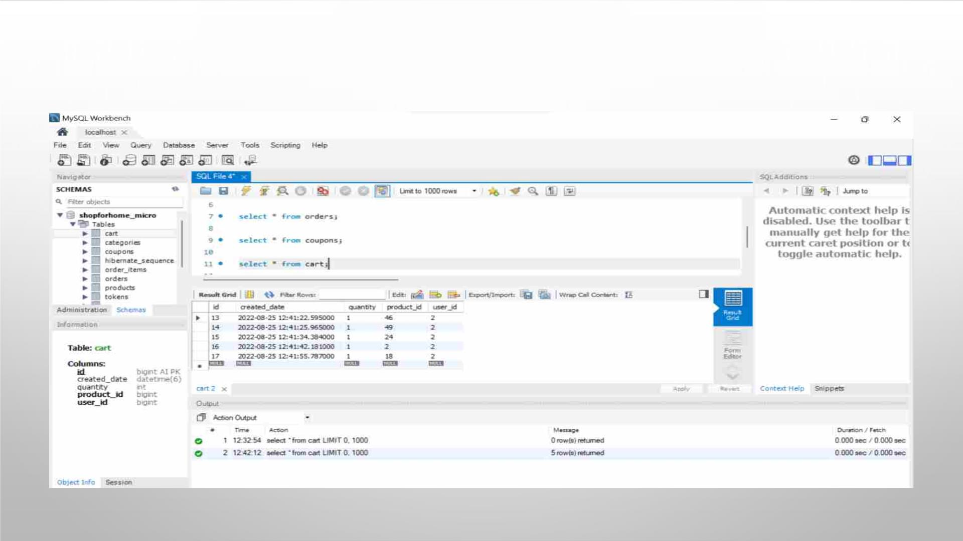
CART TABLE

Slide 14
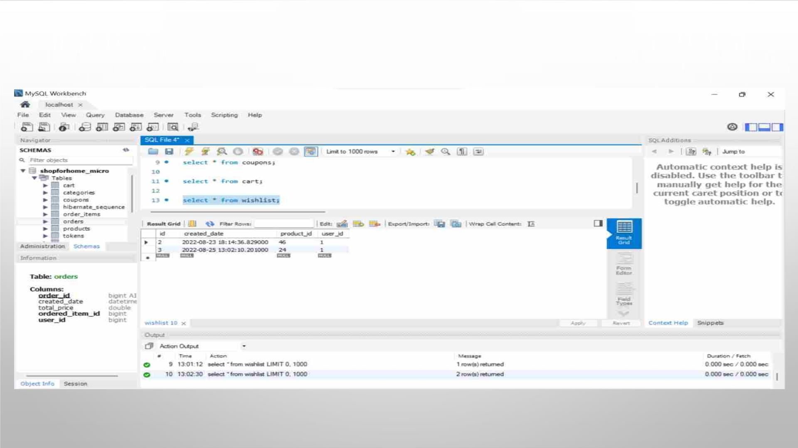
WISHLIST TABLE

Slide 15
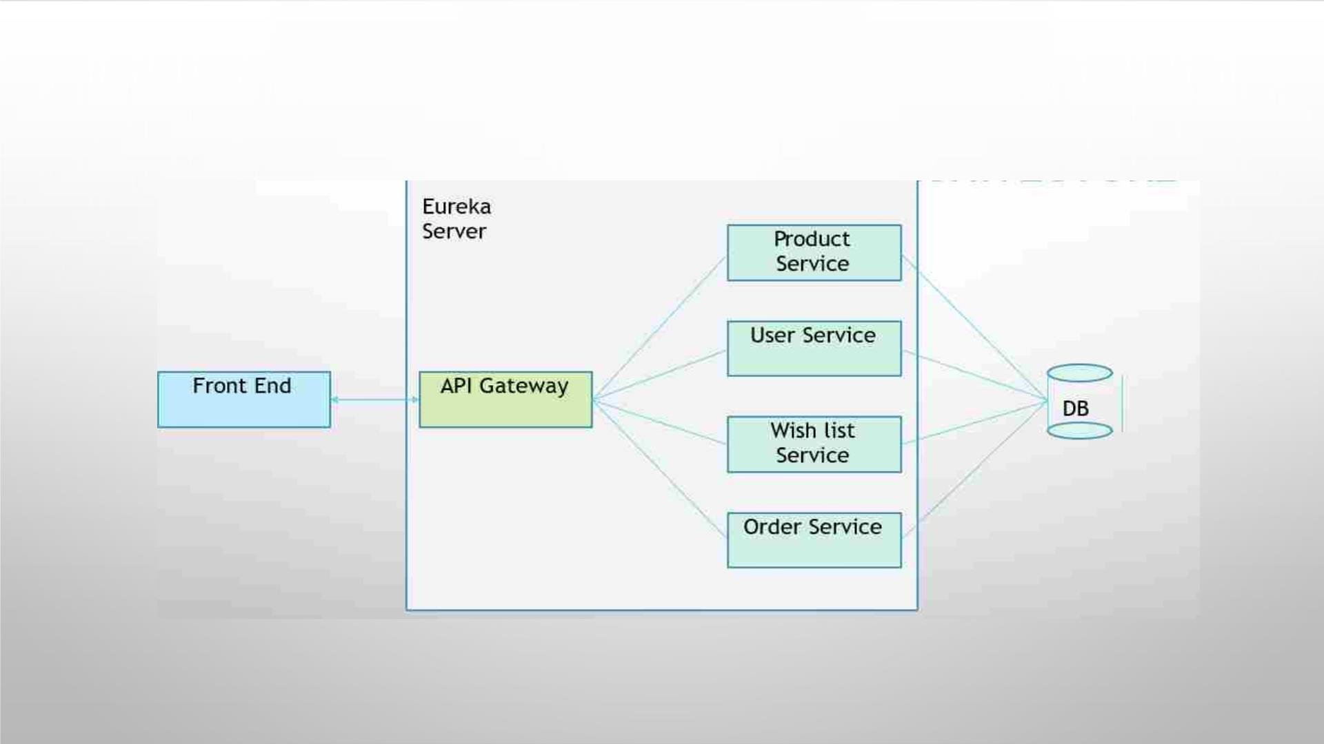
MICRO-SERVICE BASED ARCHITECTURE

Slide 16
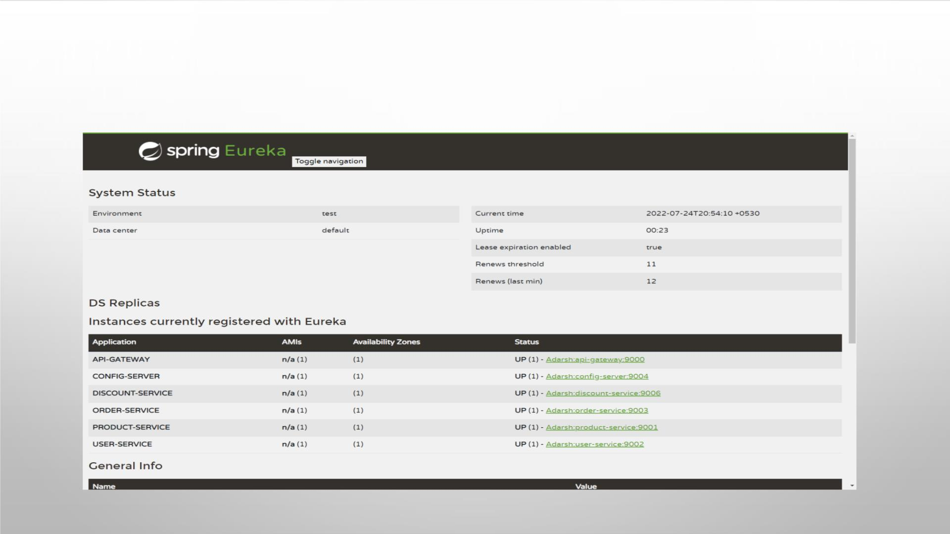
EUREKA SERVER FOR CLIENT-SERVICE
APPLICATIONS

Slide 17

Different Controllers

Slide 18
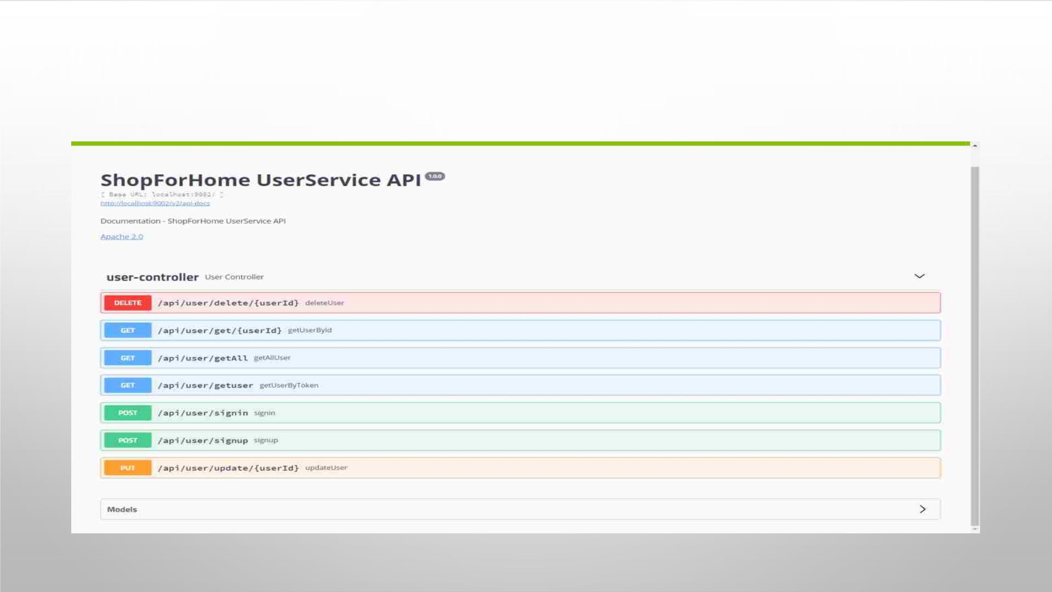
USERꢀ
CONTROLLER

Slide 19
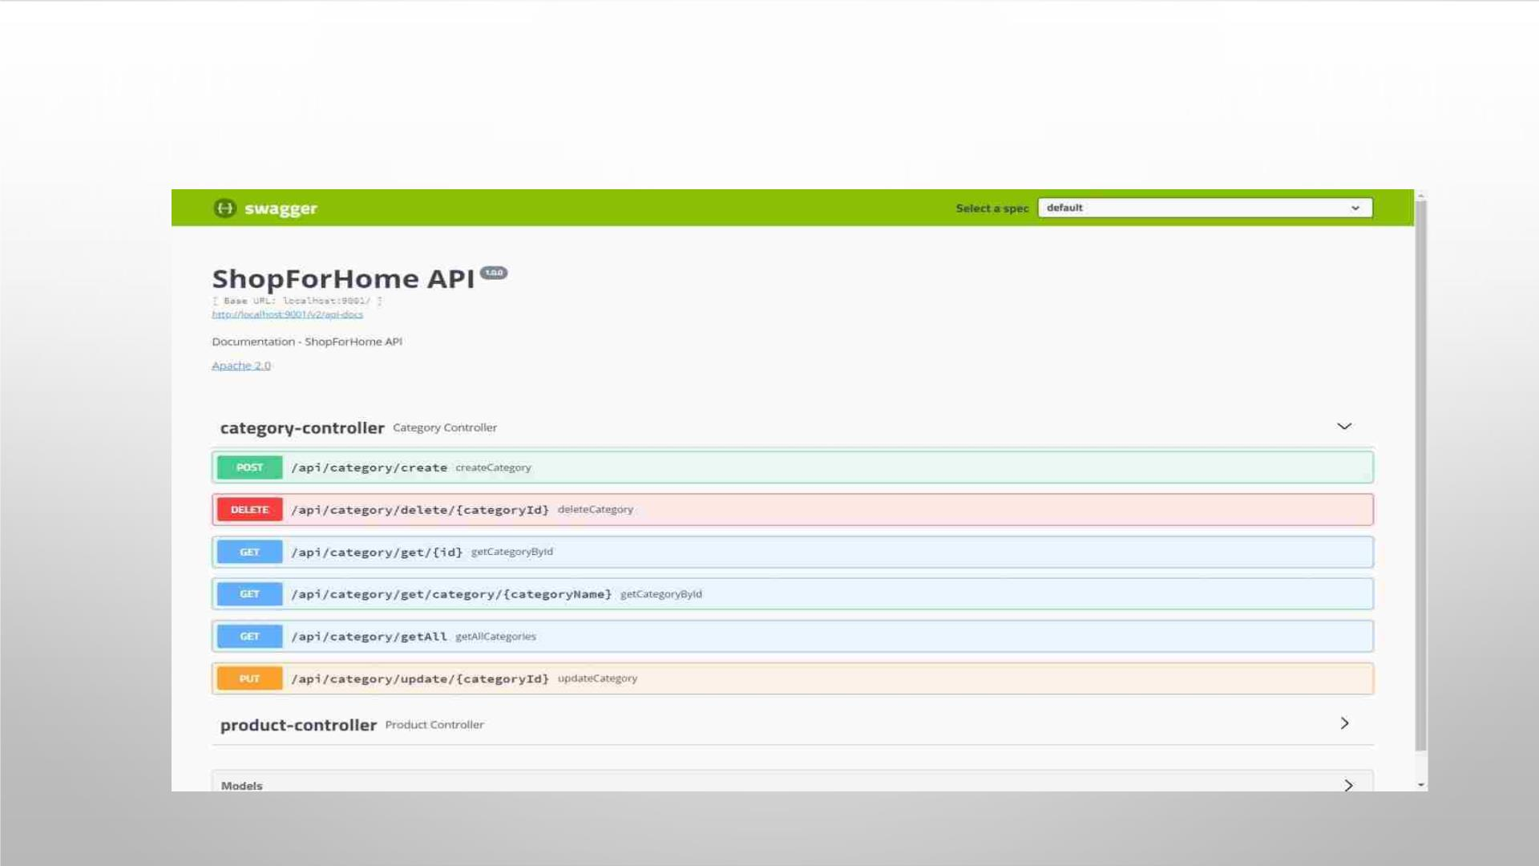
CATEGORY CONTROLLER

Slide 20
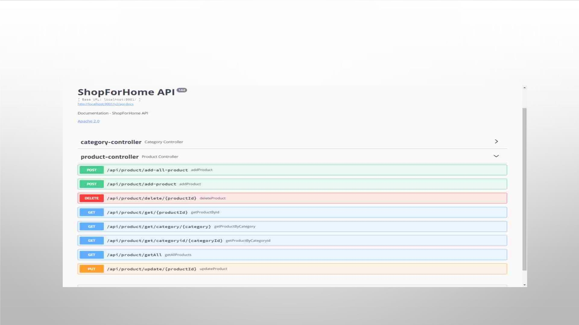
PRODUCT CONTROLLER

Slide 21
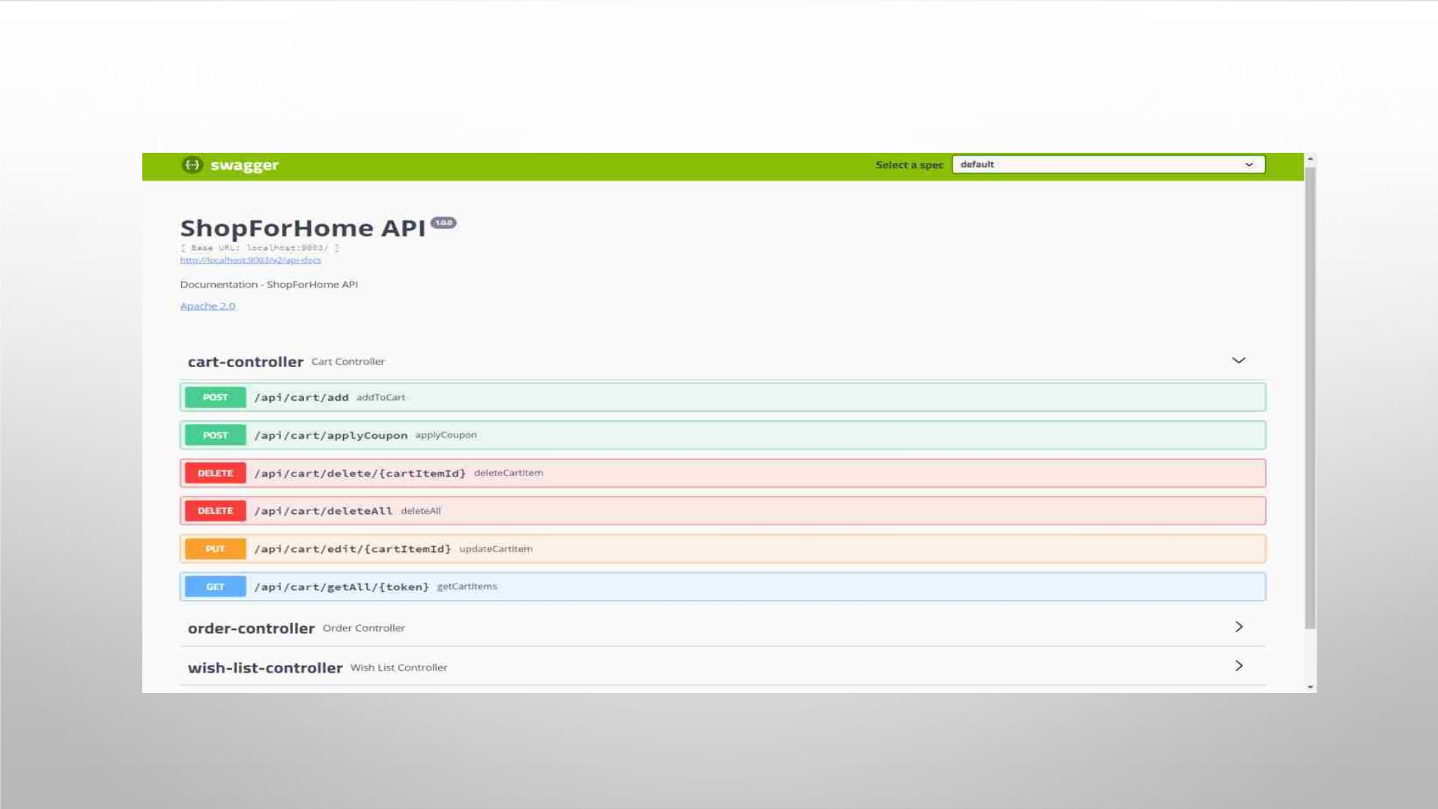
CART CONTROLLER

Slide 22
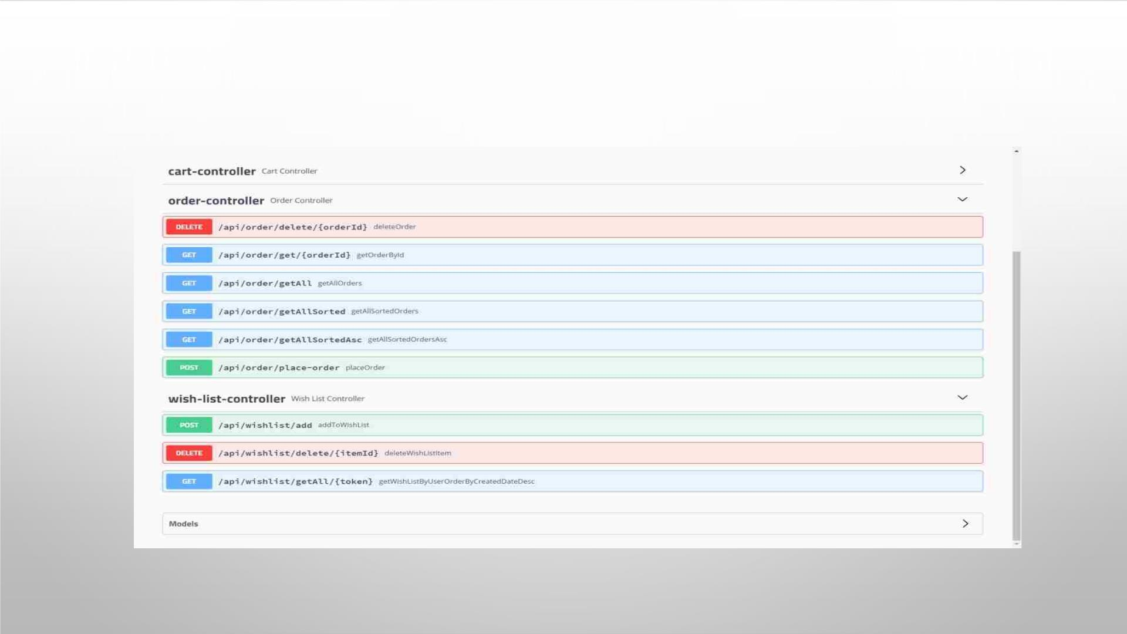
ORDER CONTROLLER

Slide 23
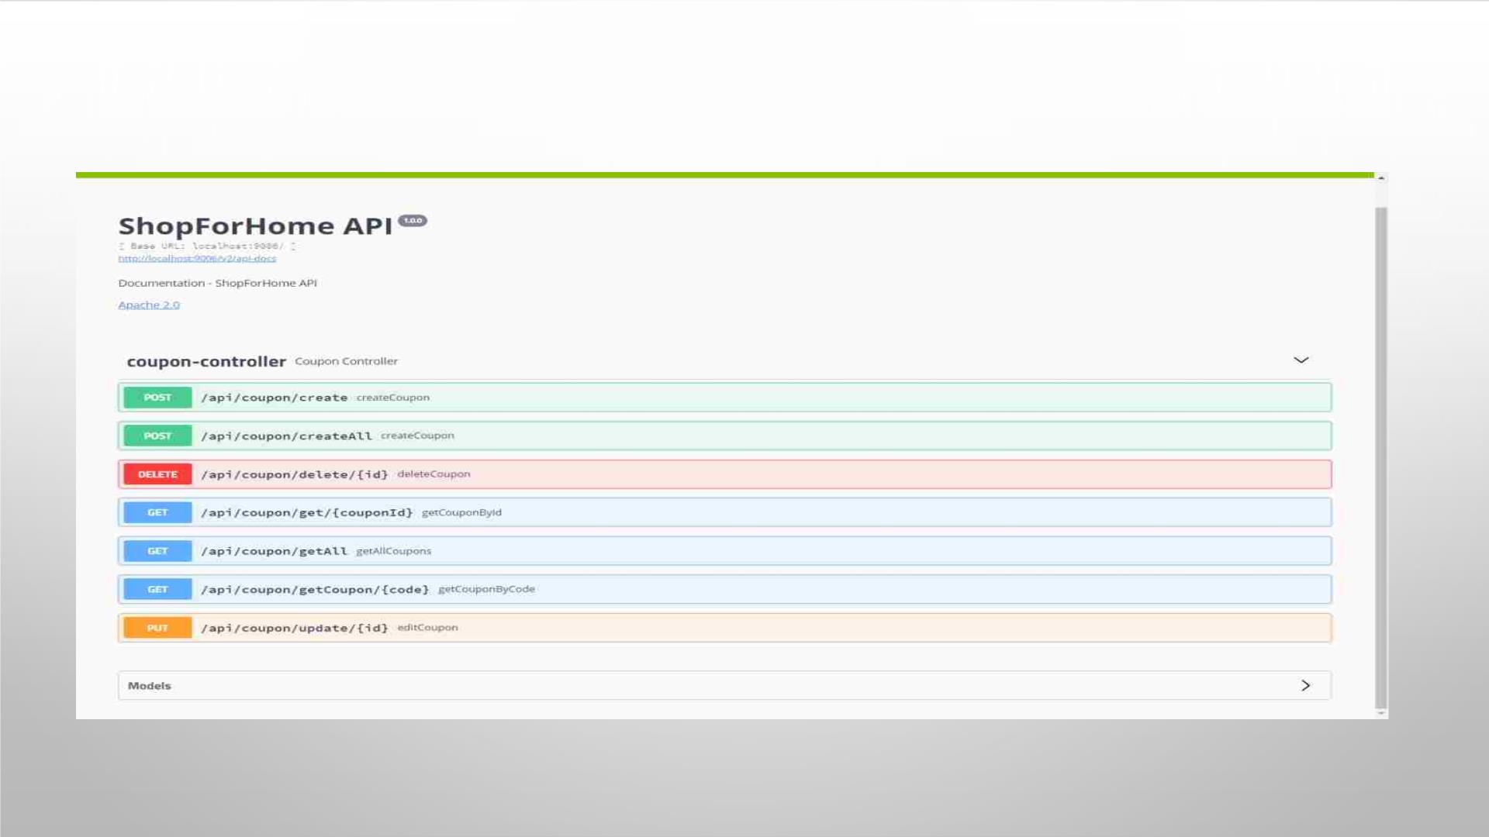
COUPON CONTROLLER

Slide 24
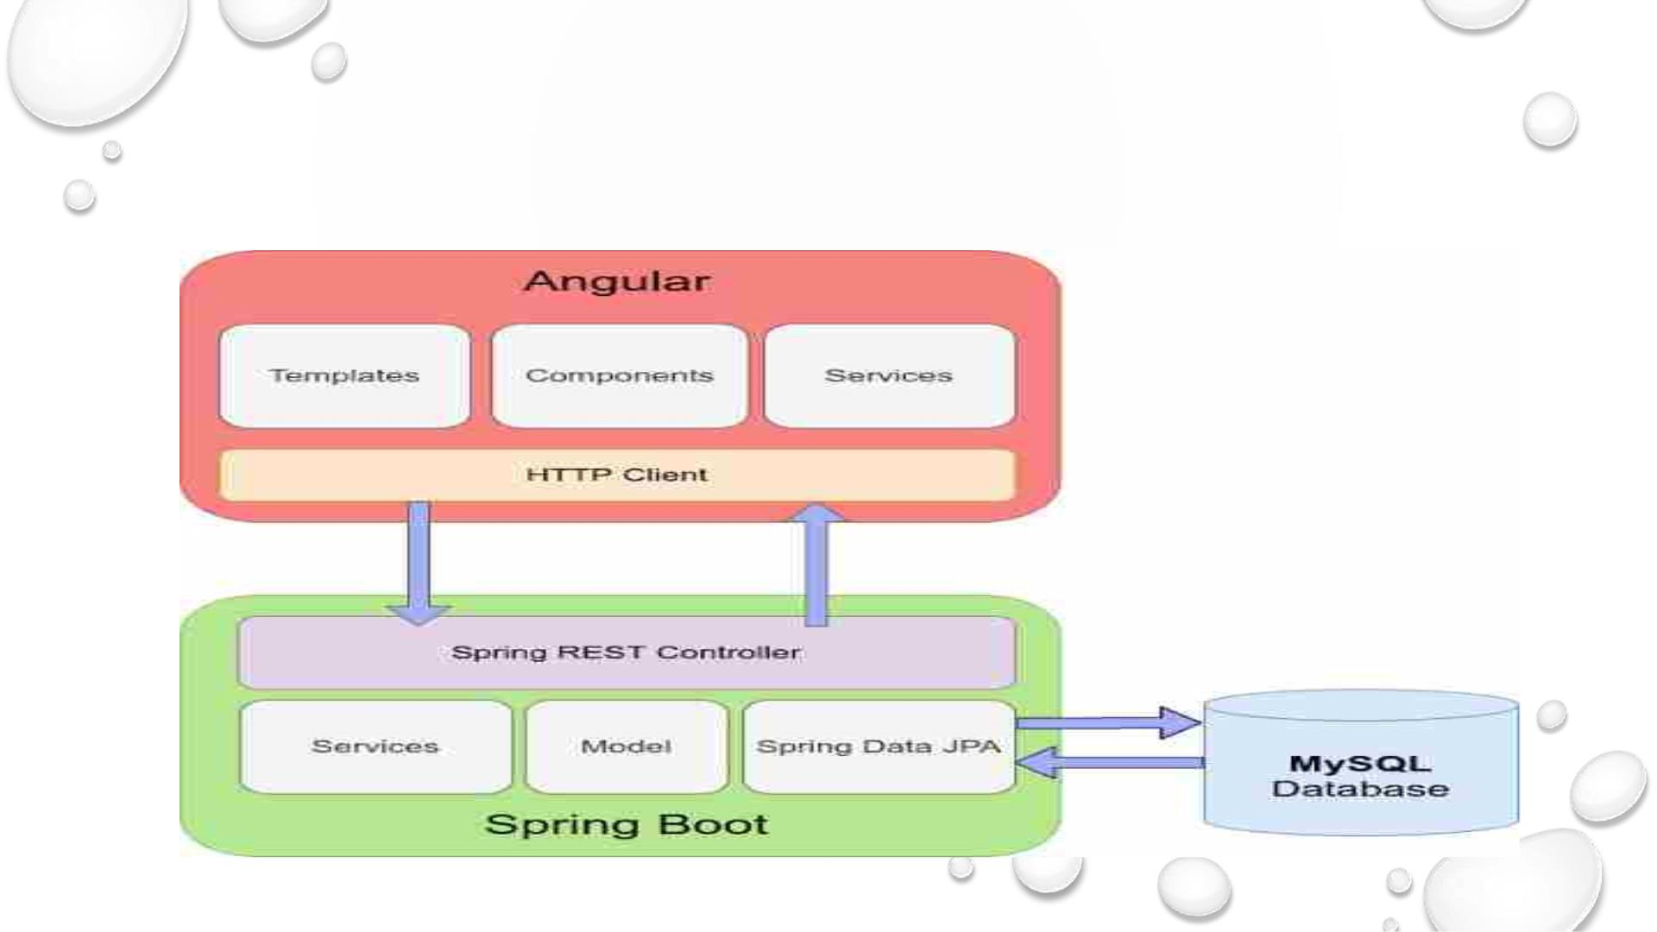
INTEGRATION OF BACKEND AND
FRONTEND STRUCTURE

Slide 25

RESPONSIVENESS OF OUR APPLICATION

Slide 26
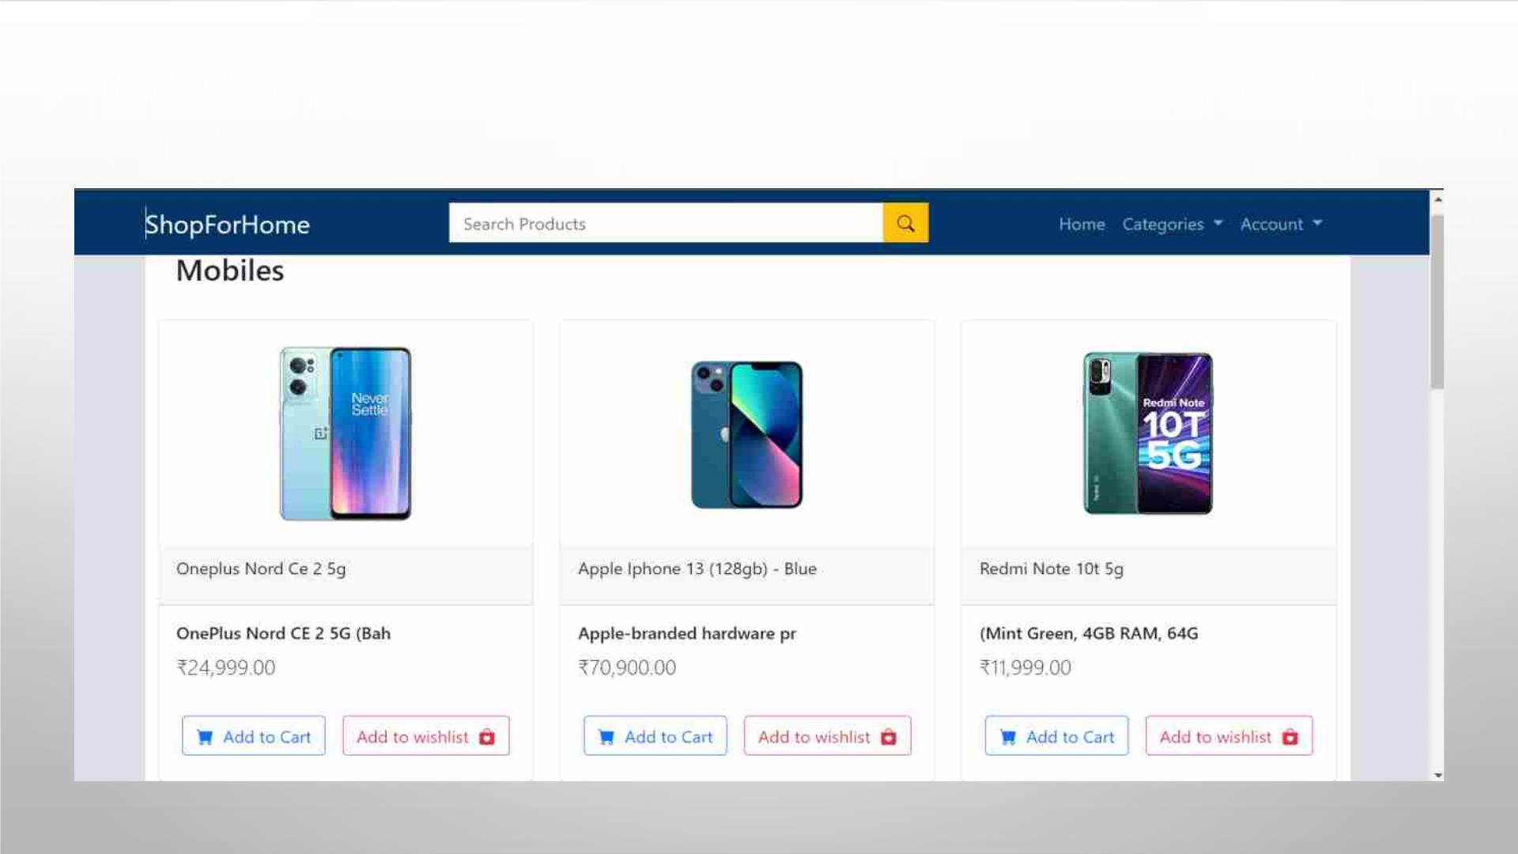
ON A LAPTOP

Slide 27

USER STORIES
• AS A USER I SHOULD BE ABLE TO LOGIN, LOGOUT AND REGISTER INTO THE APPLICATION.
• AS A USER I SHOULD BE ABLE TO SEE THE PRODUCTS IN DIFFERENT CATEGORIES.
• AS A USER I SHOULD BE ABLE TO SORT THE PRODUCTS.
• AS A USER I SHOULD BE ABLE TO ADD THE PRODUCTS INTO THE SHOPPING CART.
• AS A USER I SHOULD BE ABLE TO INCREASE OR DECREASE THE QUANTITY ADDED IN THE CART.
• AS A USER I SHOULD BE ABLE TO ADD “N” NUMBER OF PRODUCTS IN THE CART.
• AS A USER I SHOULD BE ABLE TO GET THE WISHLIST OPTION WHERE I CAN ADD THOSE
PRODUCTS WHICH I WANT BUT DON’T WANT TO ORDER NOW.
• AS A USER I SHOULD GET DIFFERENT DISCOUNT COUPONS

Slide 28
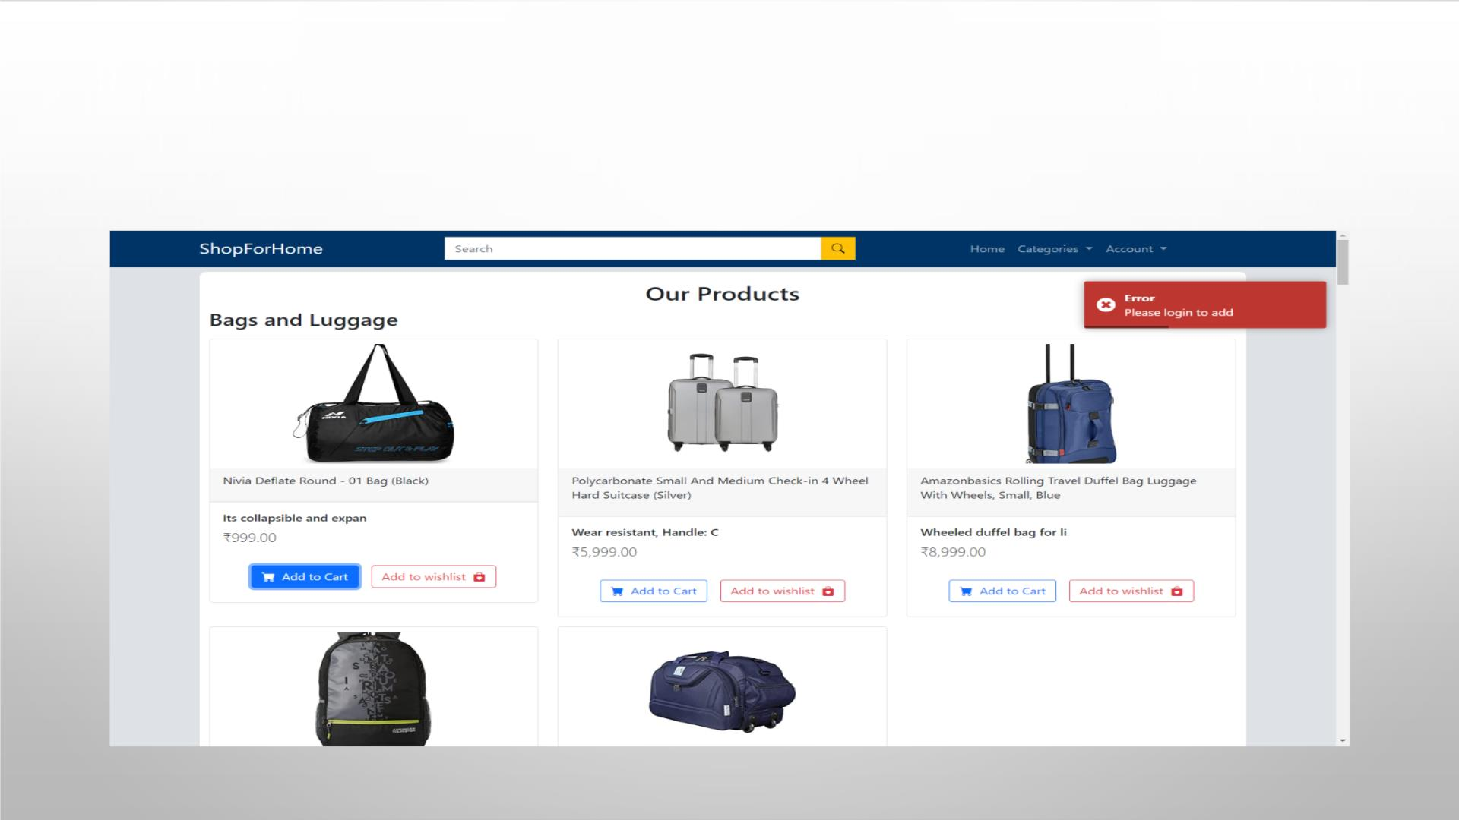
ERROR ALERT IF THE USER TRIES TO ADD PRODUCT TO THE CART, IF
NOT LOGGED IN

Slide 29
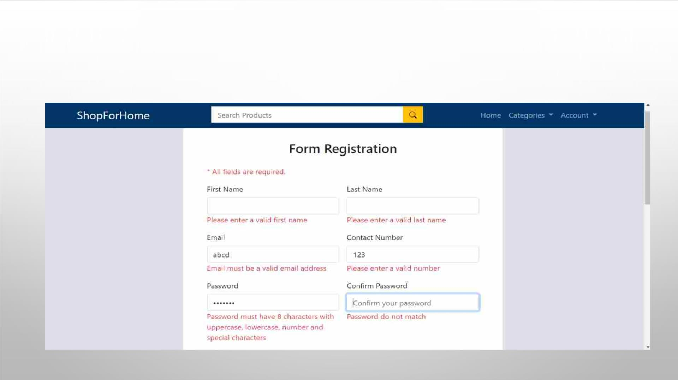
USER REGISTRATION FORM WITH VALIDATION

Slide 30
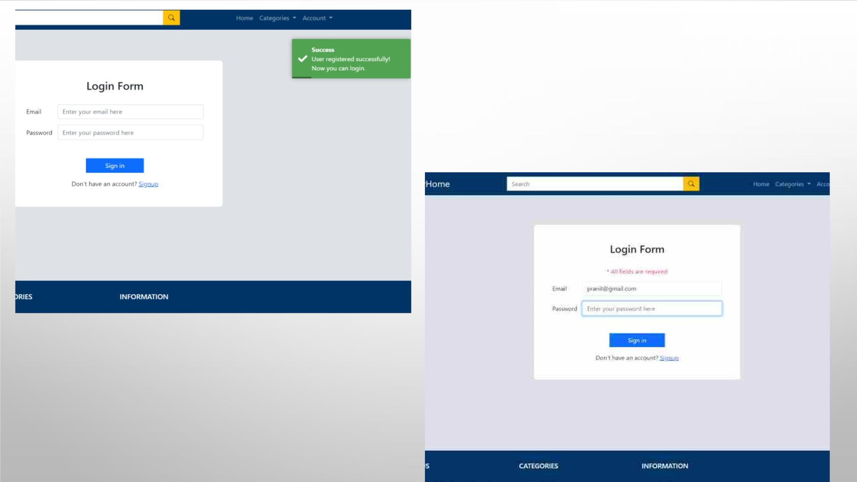
LOGIN FORM
ALERT MESSAGE THAT ALL FIELDS ARE
REQUIRED

Slide 31
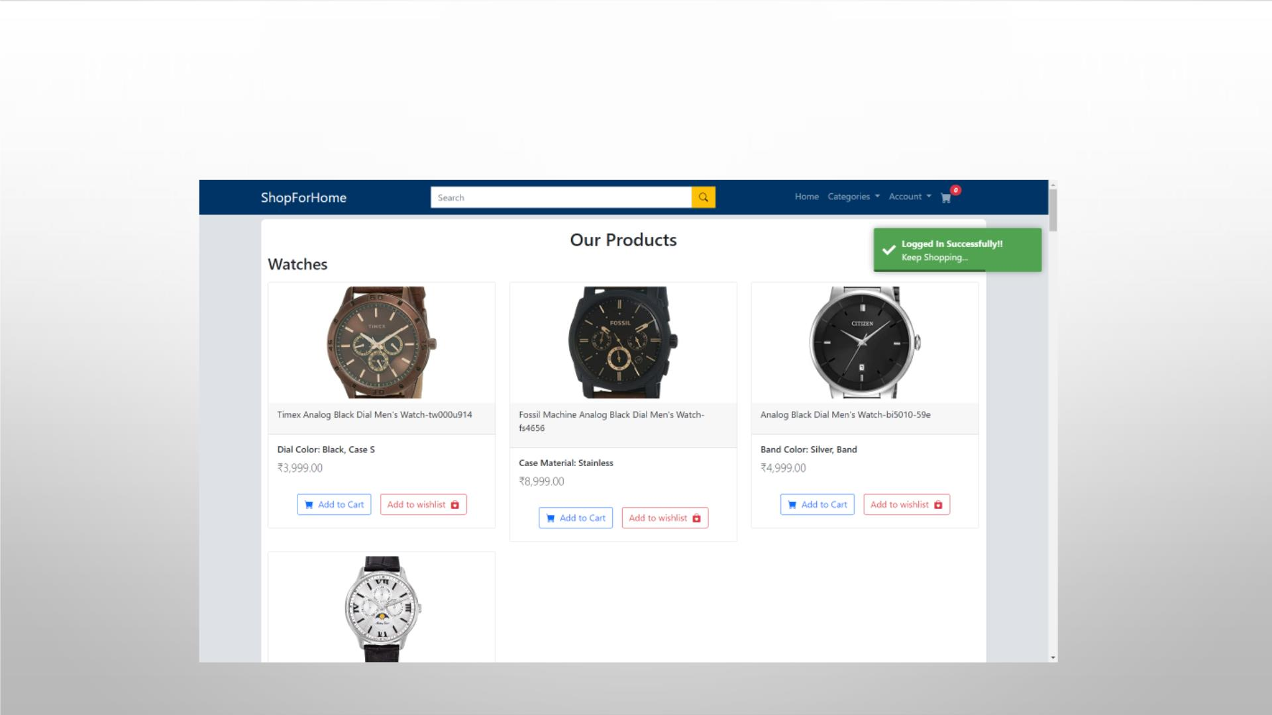
ALERT MESSAGE THAT LOGGED IN SUCCESSFULLY

Slide 32
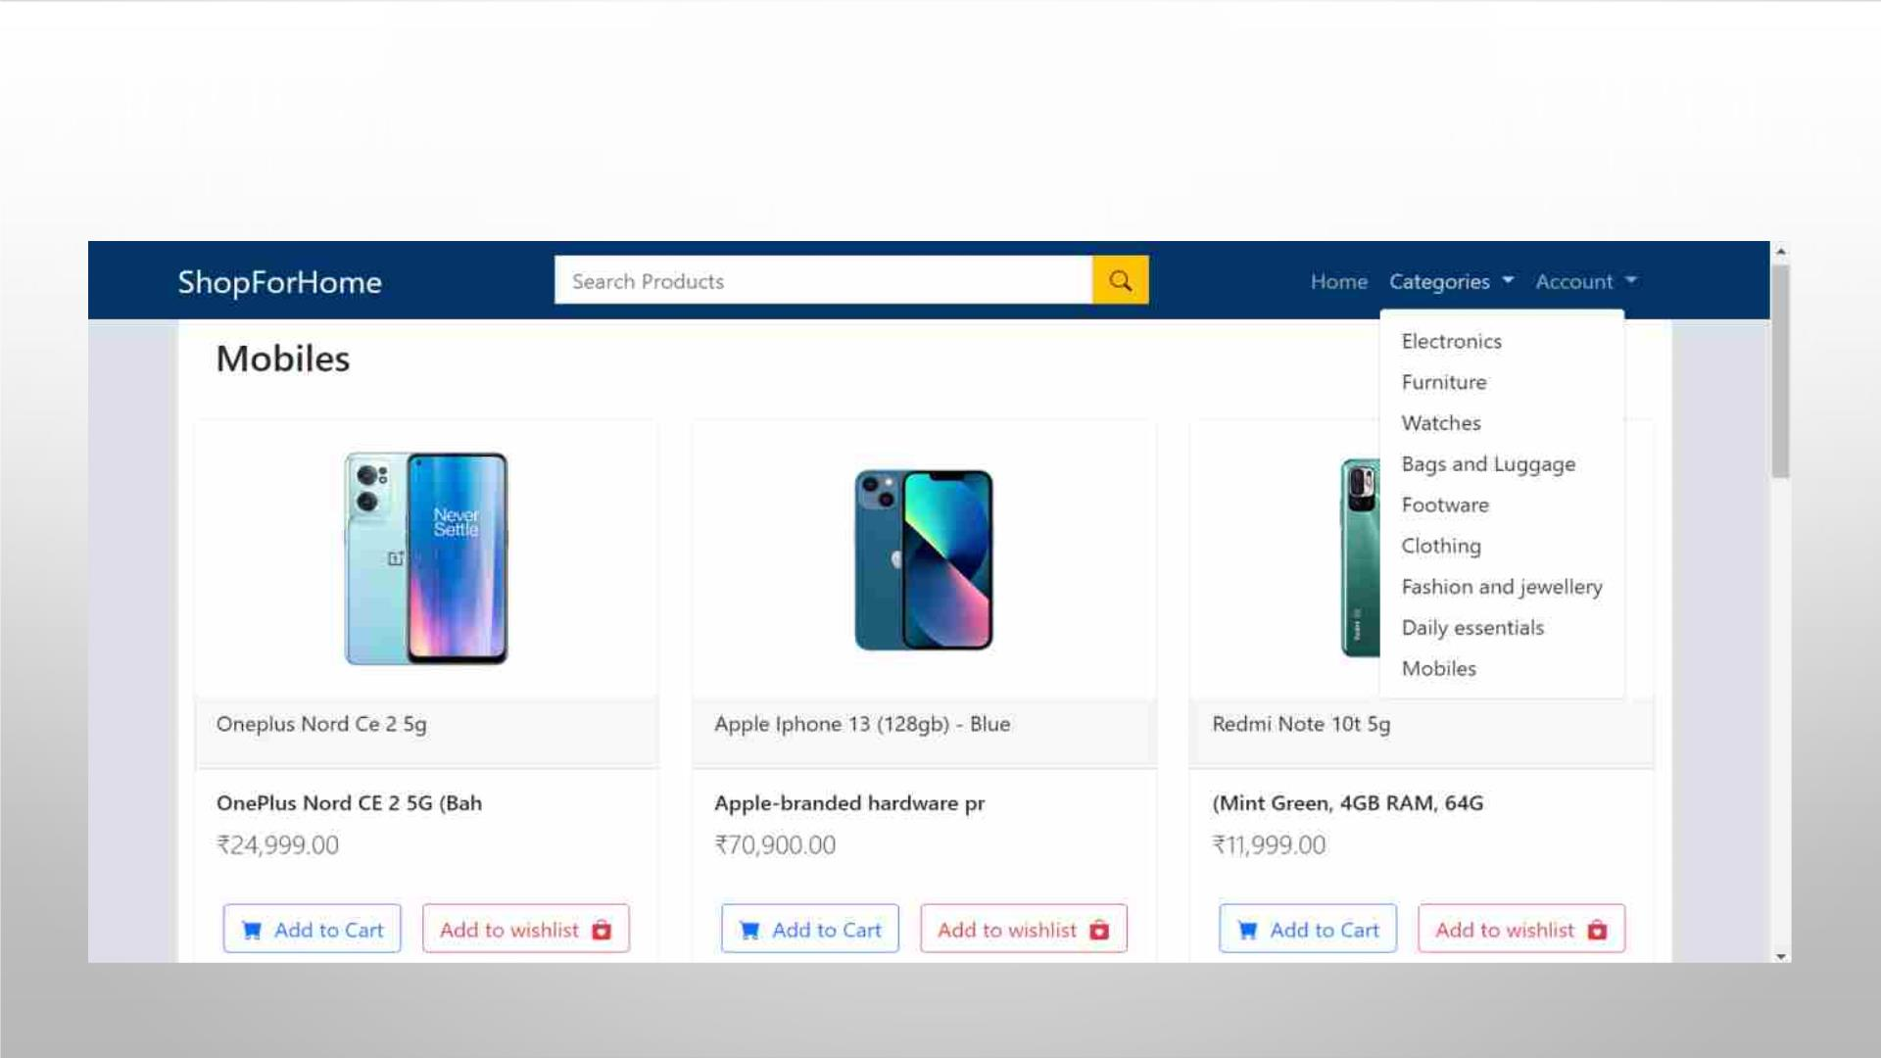
USER SHOULD SEE THE PRODUCTS IN DIFFERENT CATEGORIES

Slide 33
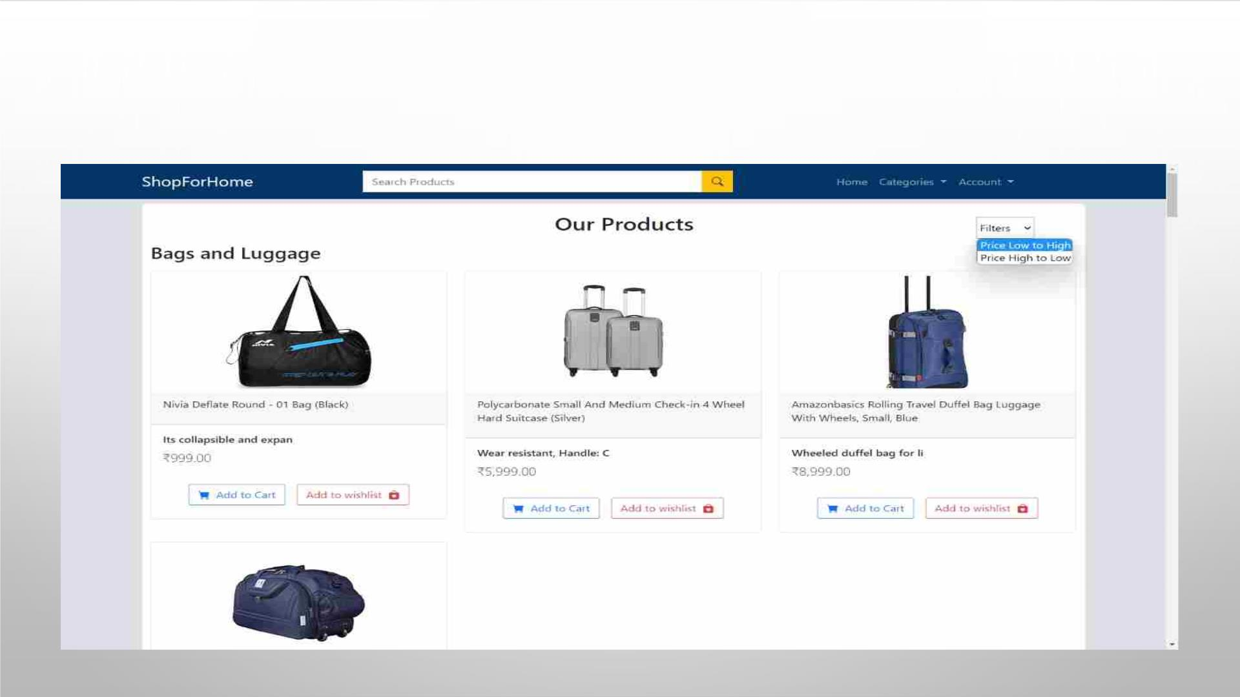
USER SHOULD BE ABLE TO SEARCH THE PRODUCTS

Slide 34
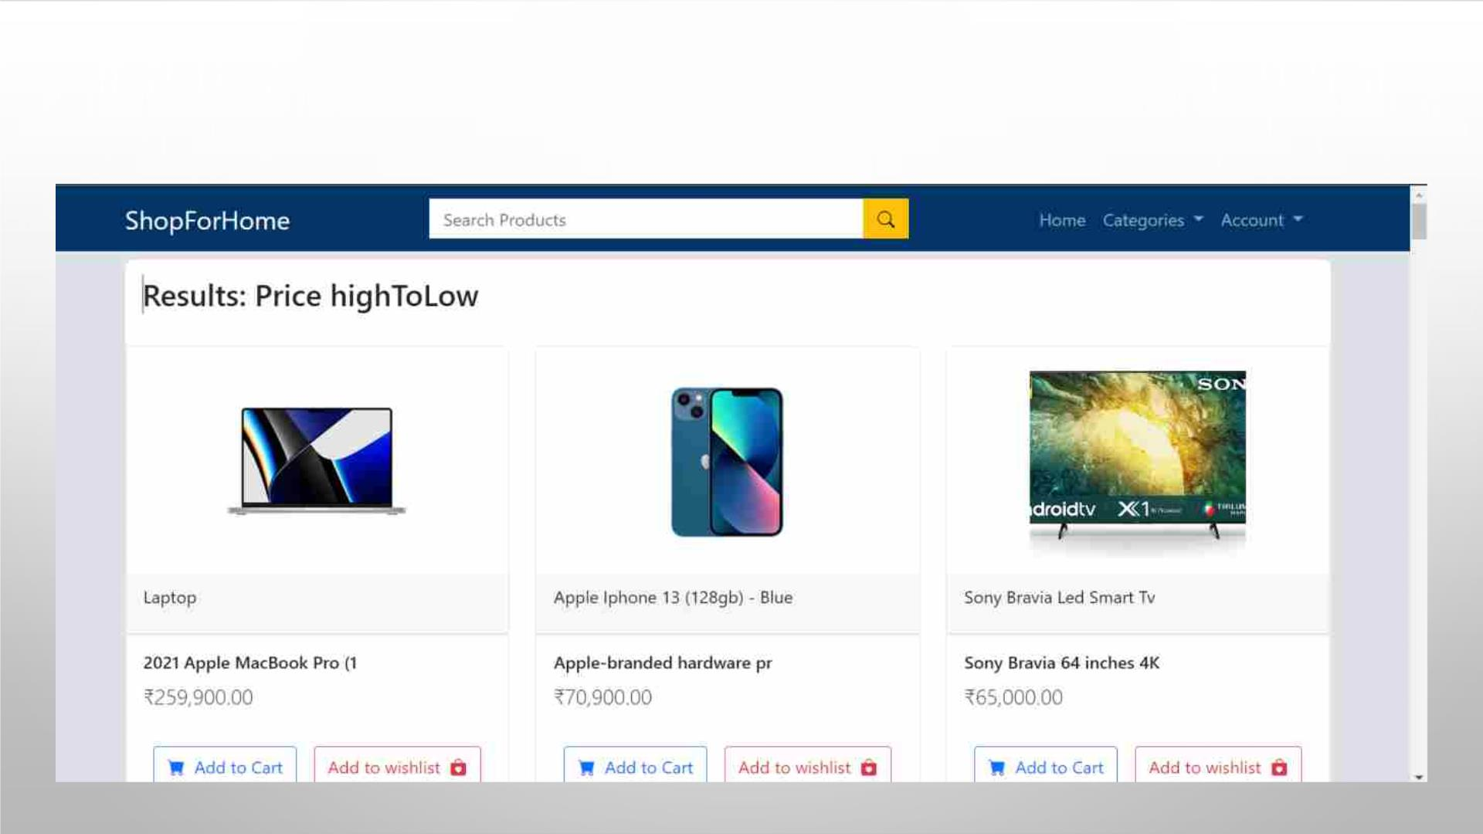
USER SHOULD BE ABLE TO SORT THE PRODUCTS

Slide 35
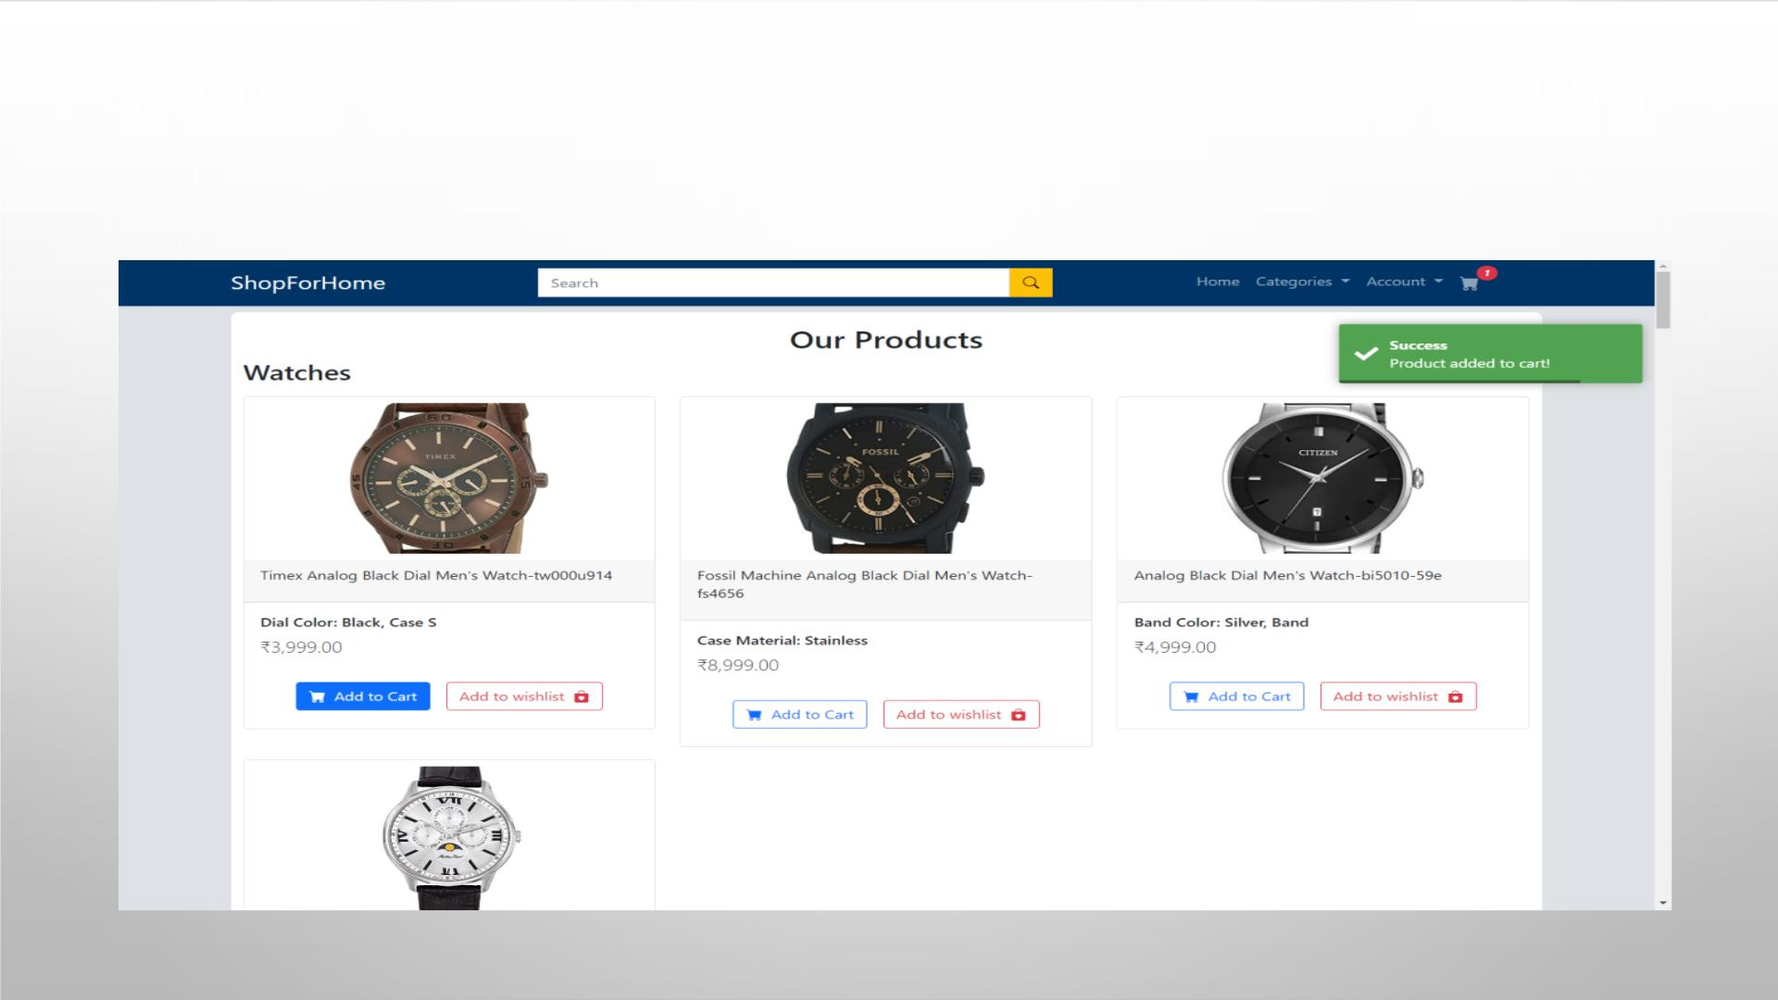
USER SHOULD BE ABLE TO ADD PRODUCTS TO THE SHOPPING CART

Slide 36
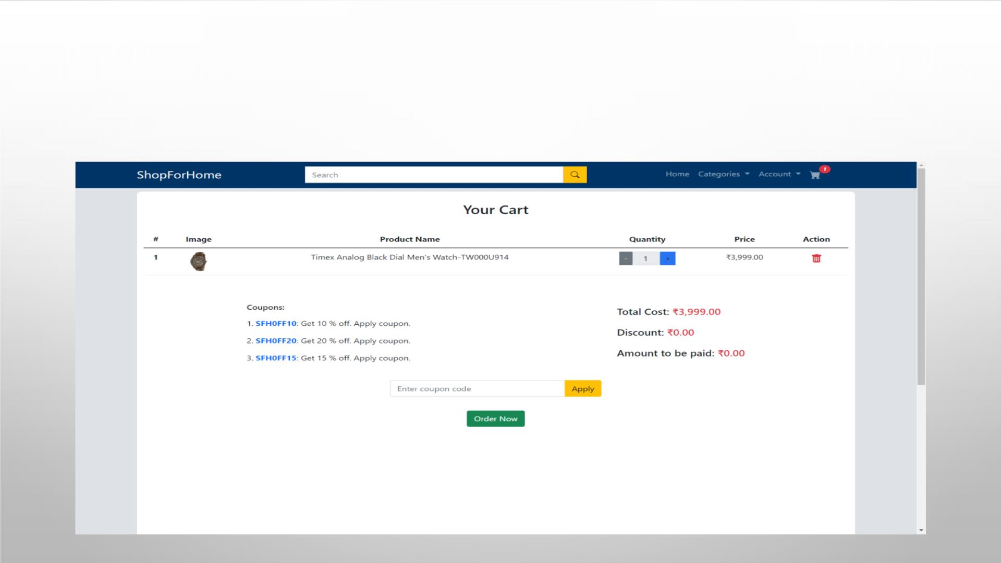
USER SHOULD BE ABLE TO INCREASE OR DECREASE THE QUANTITY
ADDED IN THE CART

Slide 37
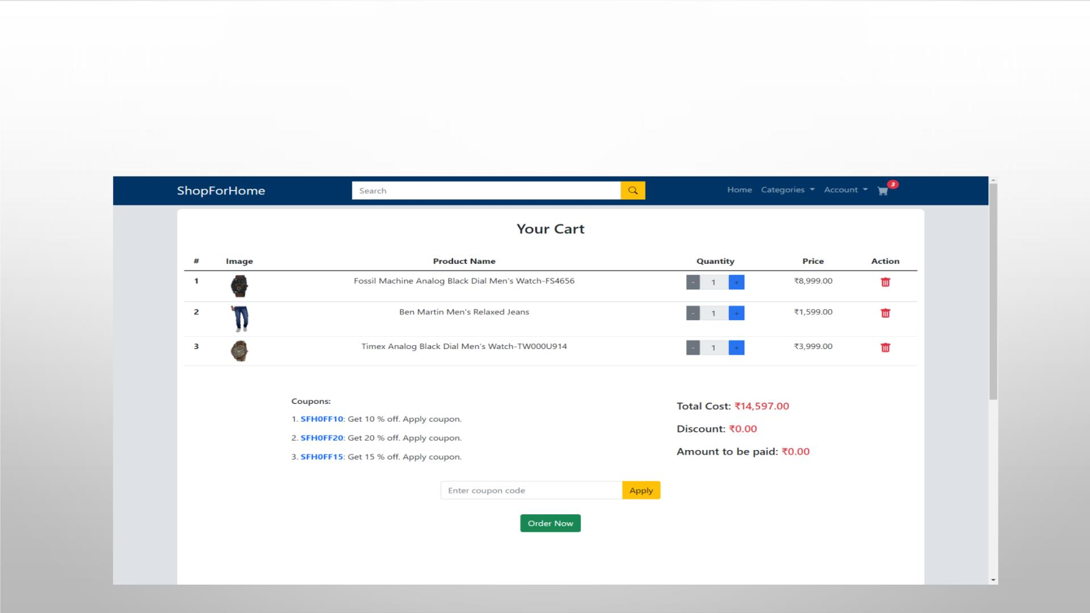
USER SHOULD BE ABLE TO ADD ‘N’ NUMBER OF PRODUCTS IN THE
CART

Slide 38
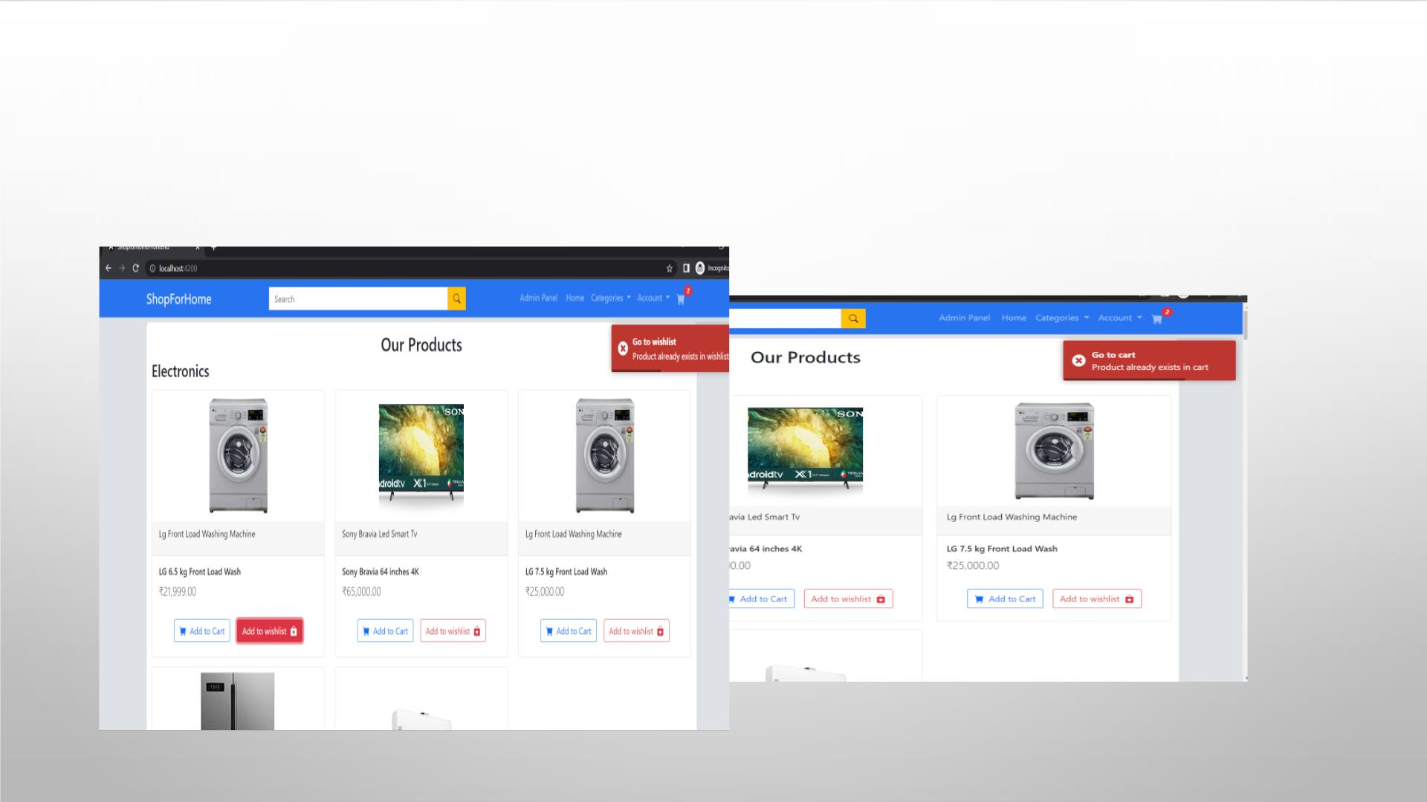
ALERT MESSAGE IF THE PRODUCT IS ALREADY IN THE CART OR
WISHLIST

Slide 39
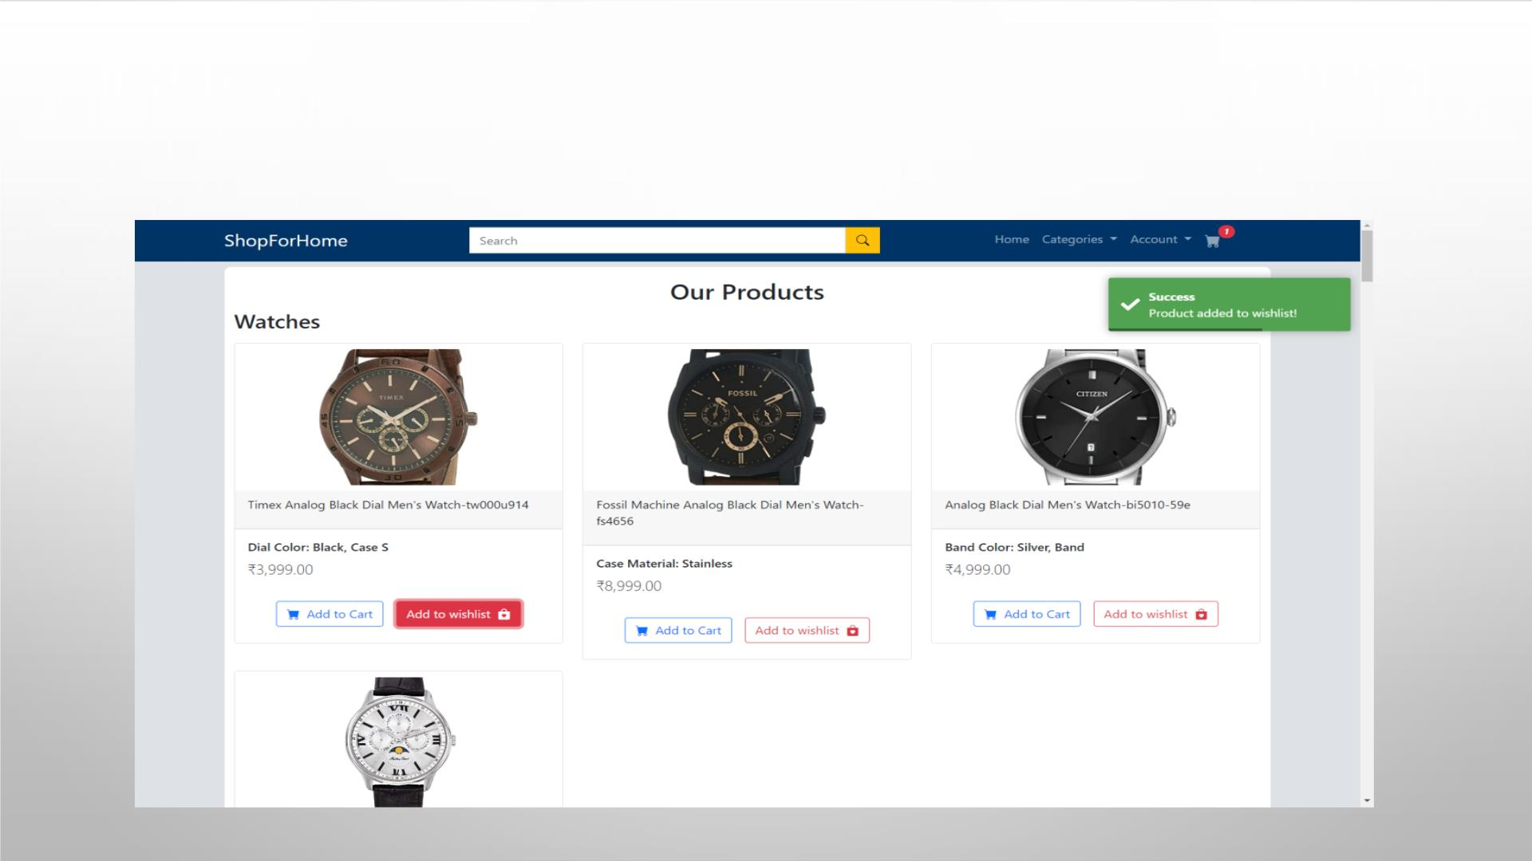
USER SHOULD BE ABLE TO GET THE WISHLIST OPTION

Slide 40
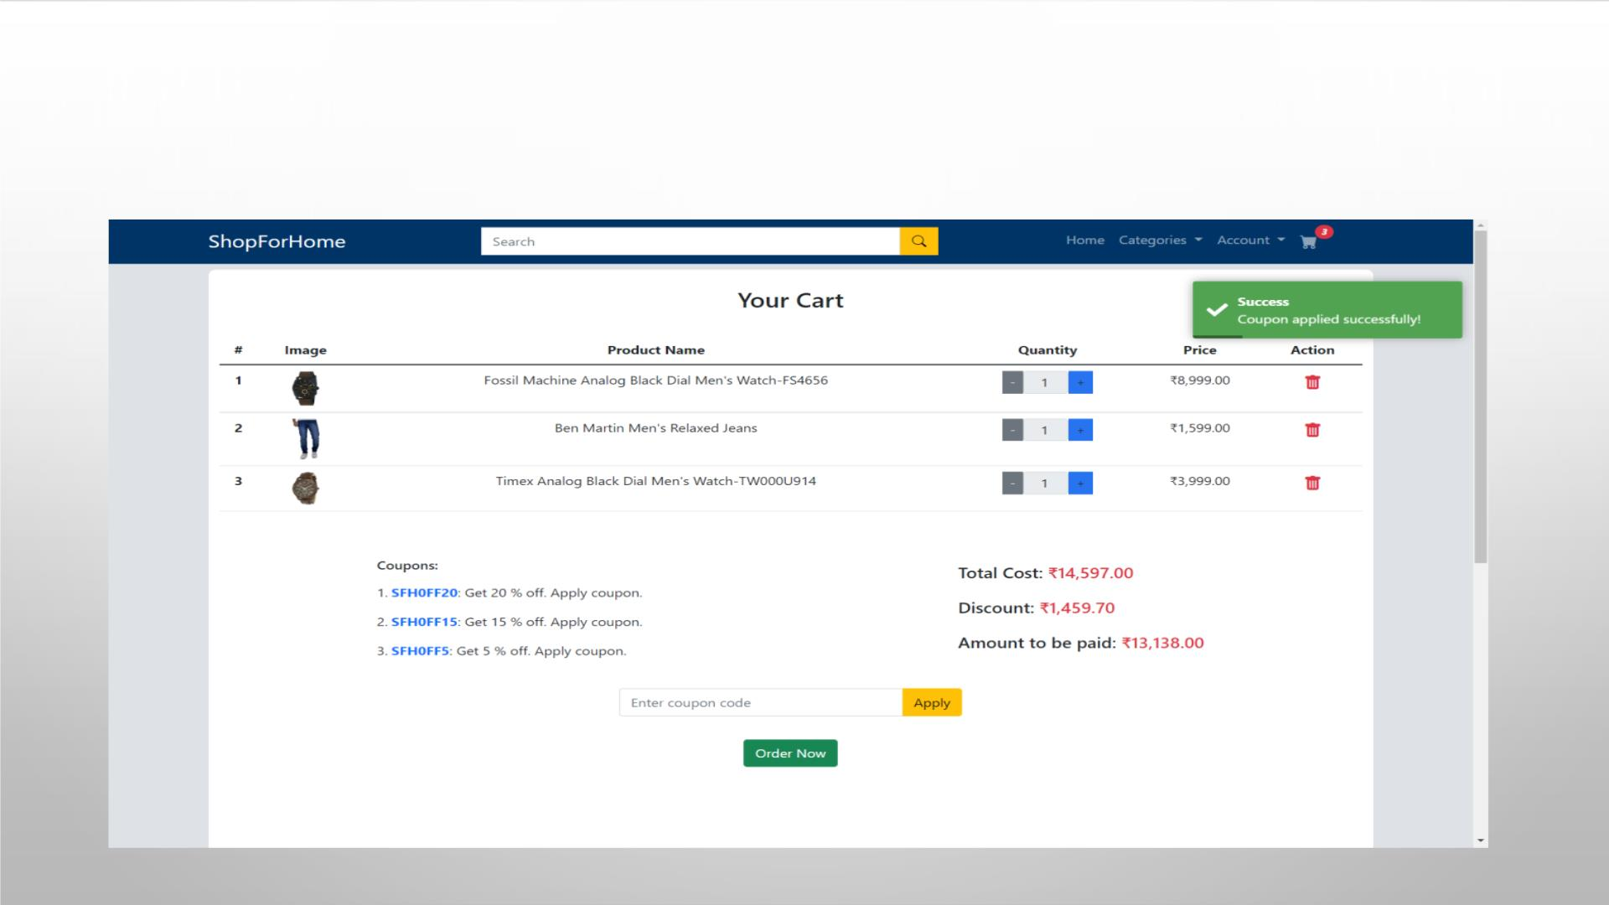
USER SHOULD BE ABLE TO APPLY DISCOUNT COUPONS

Slide 41
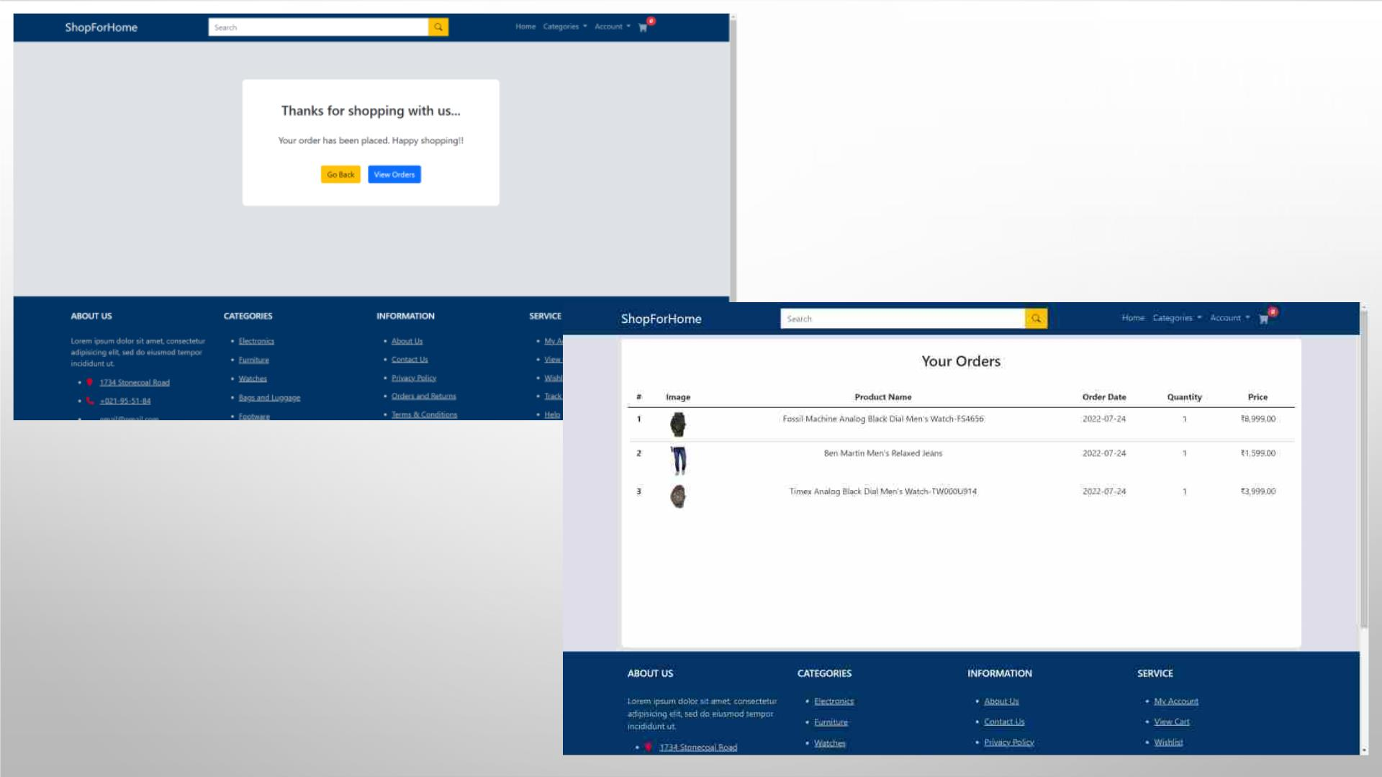
USER CAN NAVIGATE
THROUGH ORDER SUMMARY

Slide 42
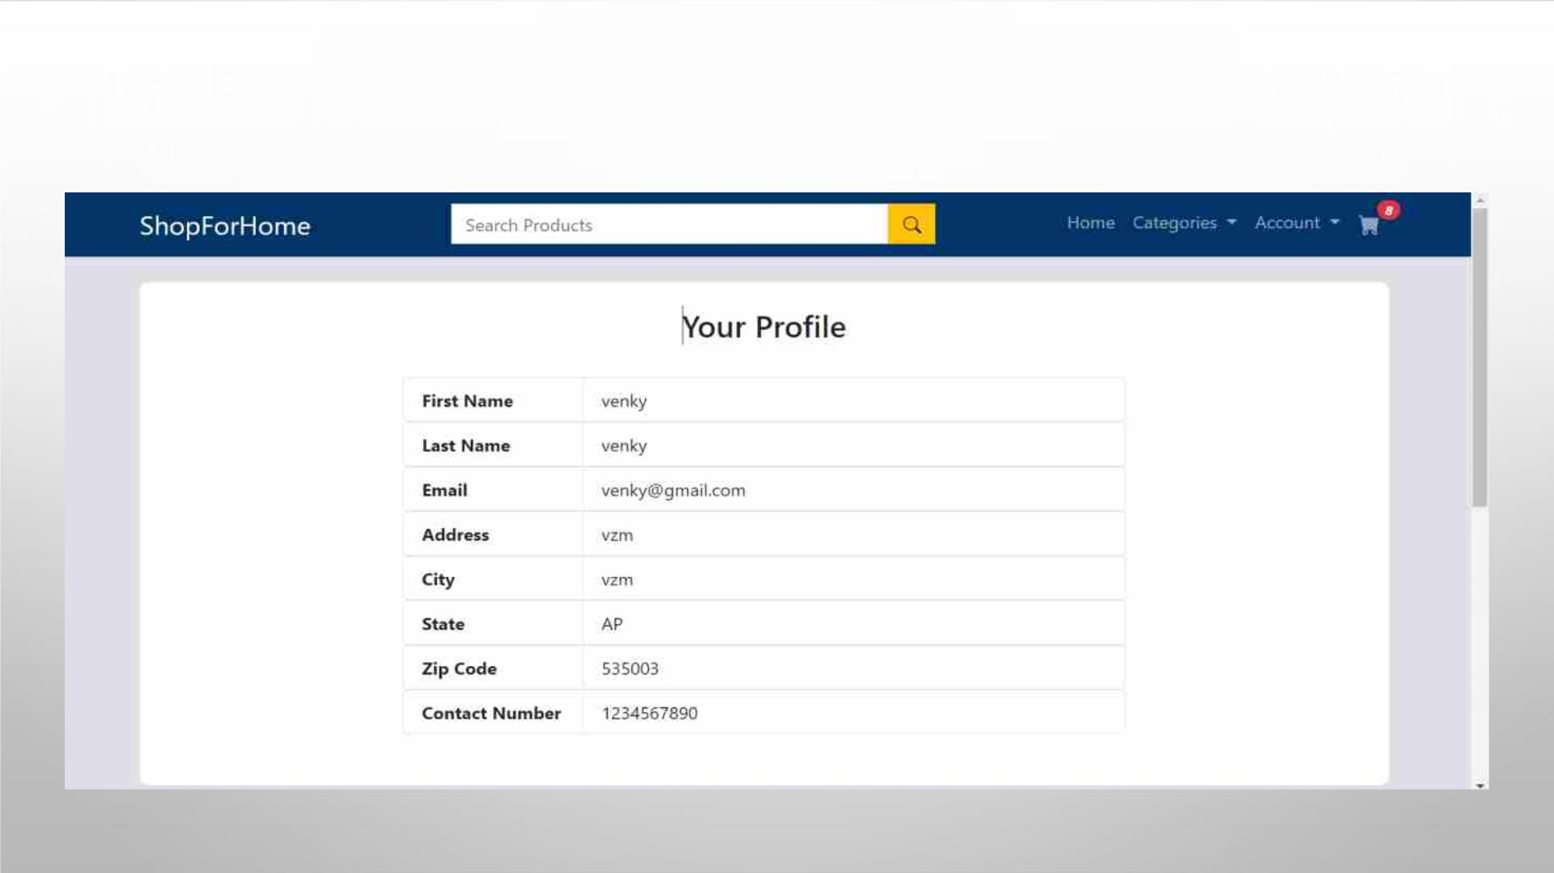
USER PROFILE

Slide 43
ADMIN STORIES
• AS AN ADMIN I SHOULD BE ABLE TO LOGIN, LOGOUT AND REGISTER INTO
THE APPLICATION.
• AS AN ADMIN I SHOULD BE ABLE TO PERFORM CRUD ON USERS.
• AS AN ADMIN I SHOULD BE ABLE TO PERFORM CRUD ON THE PRODUCTS.
• AS AN ADMIN I SHOULD BE ABLE TO GET THE STOCKS.
• AS AN ADMIN I SHOULD BE ABLE TO GET THE SALES REPORT OF A SPECIFIC
DURATION.
• AS AN ADMIN I SHOULD BE ABLE TO SET THE DISCOUNT COUPONS FOR THE
USERS.

Slide 44
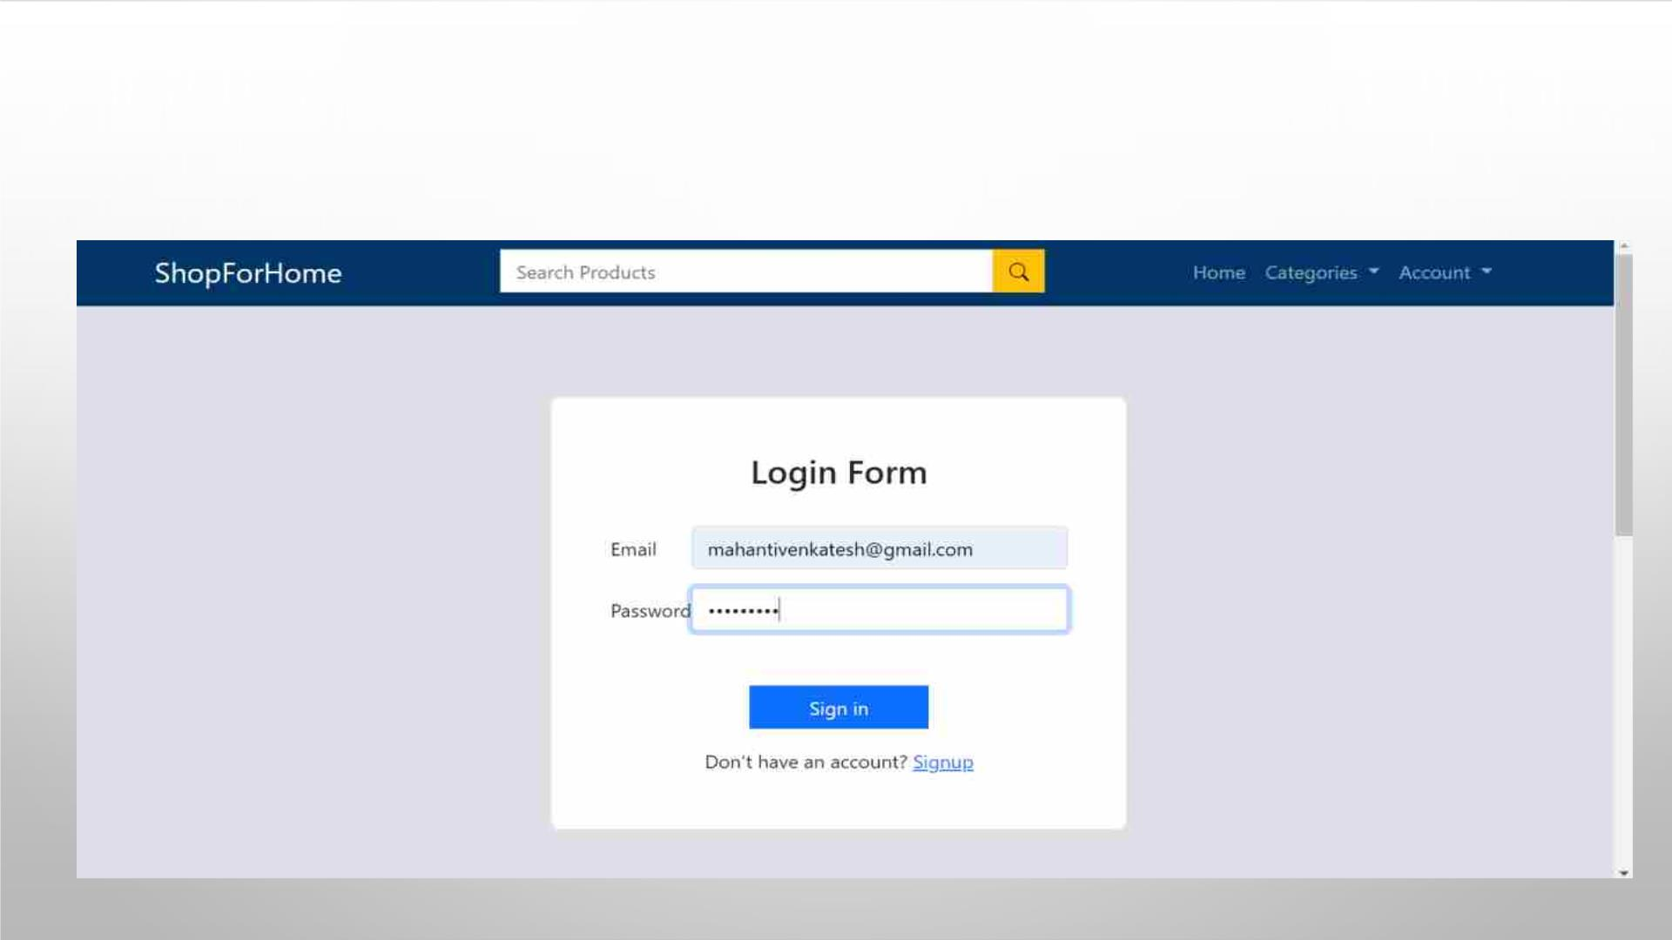
ADMIN CAN LOGIN OR REGISTER IN THE APPLICATION

Slide 45
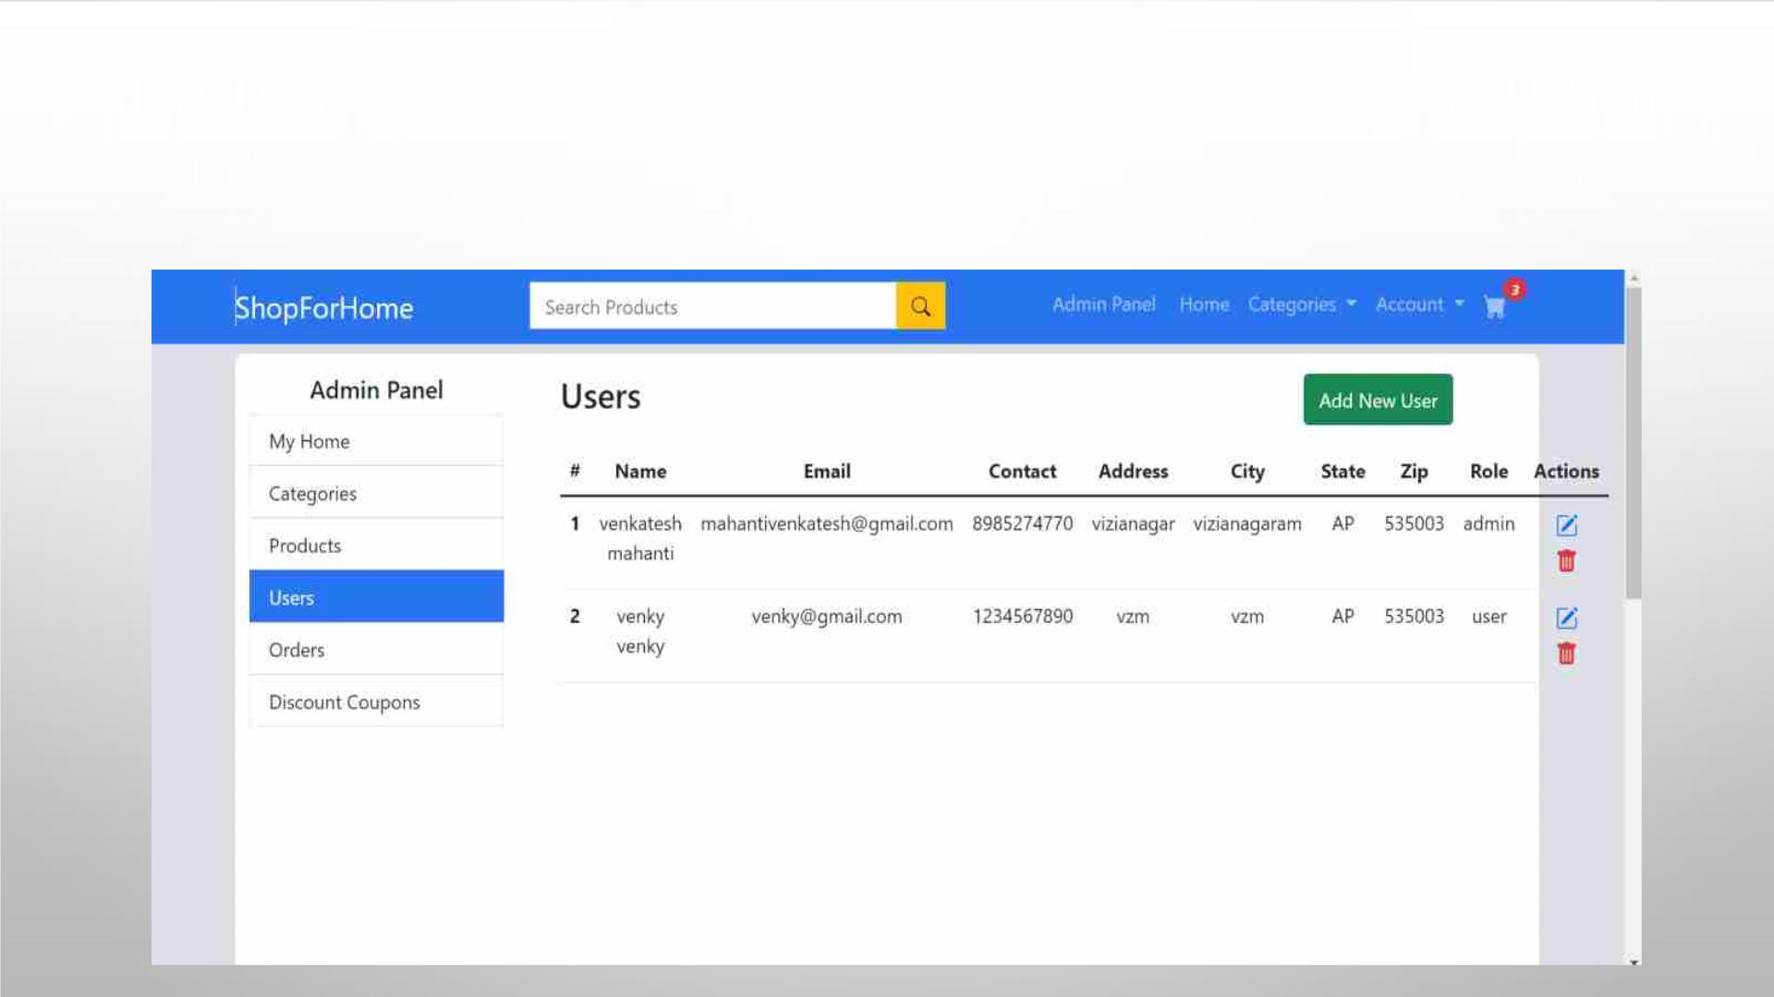
ADMIN CAN PERFORM CRUD ON USERS

Slide 46
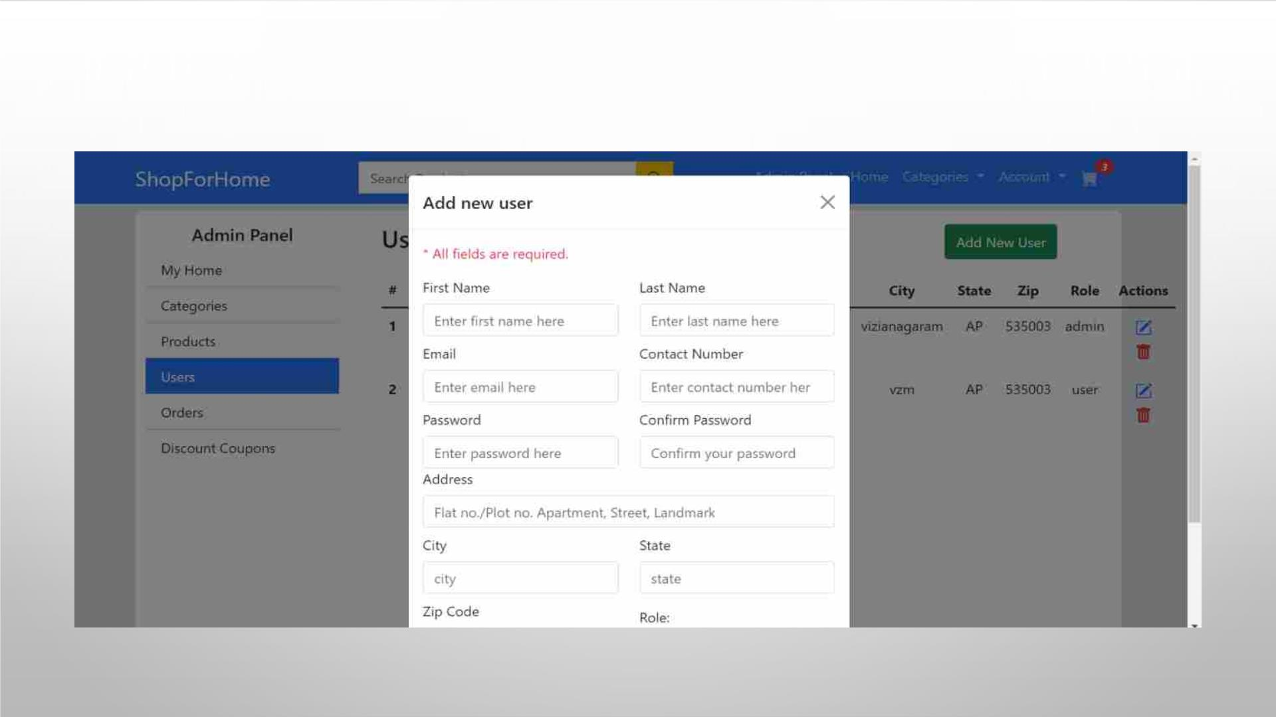
ADMIN CAN CREATE OR ADD NEW USER

Slide 47
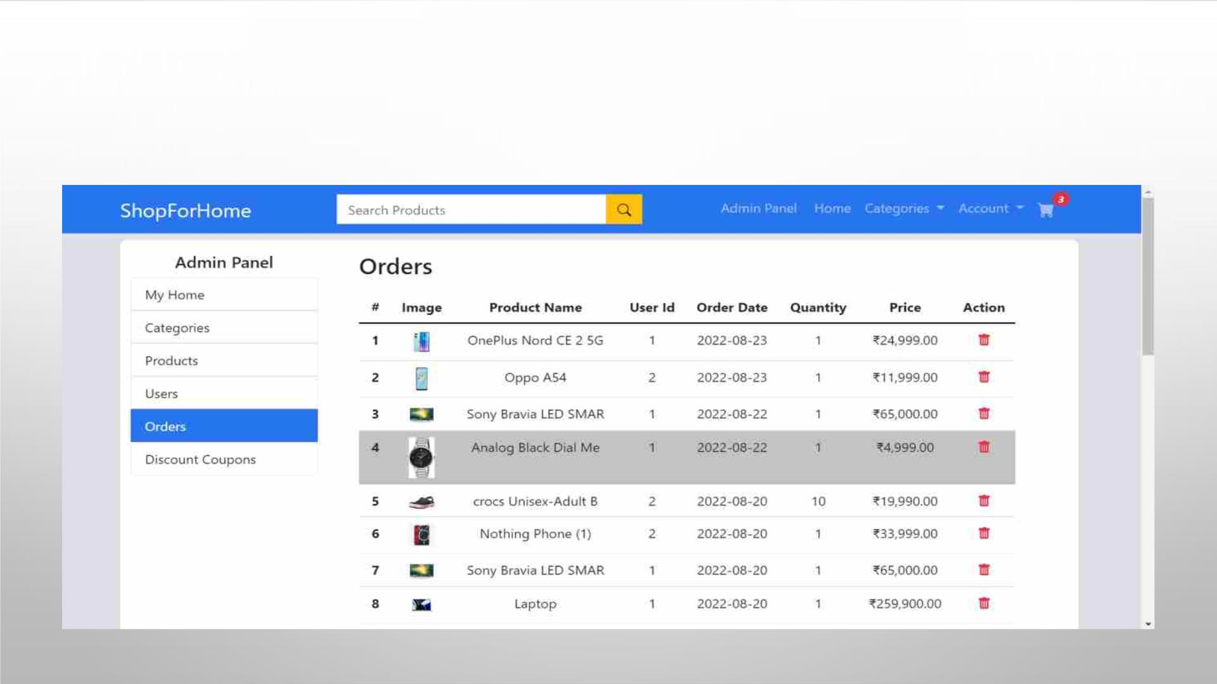
ADMIN CAN READ THE PRODUCTS AND USERS

Slide 48
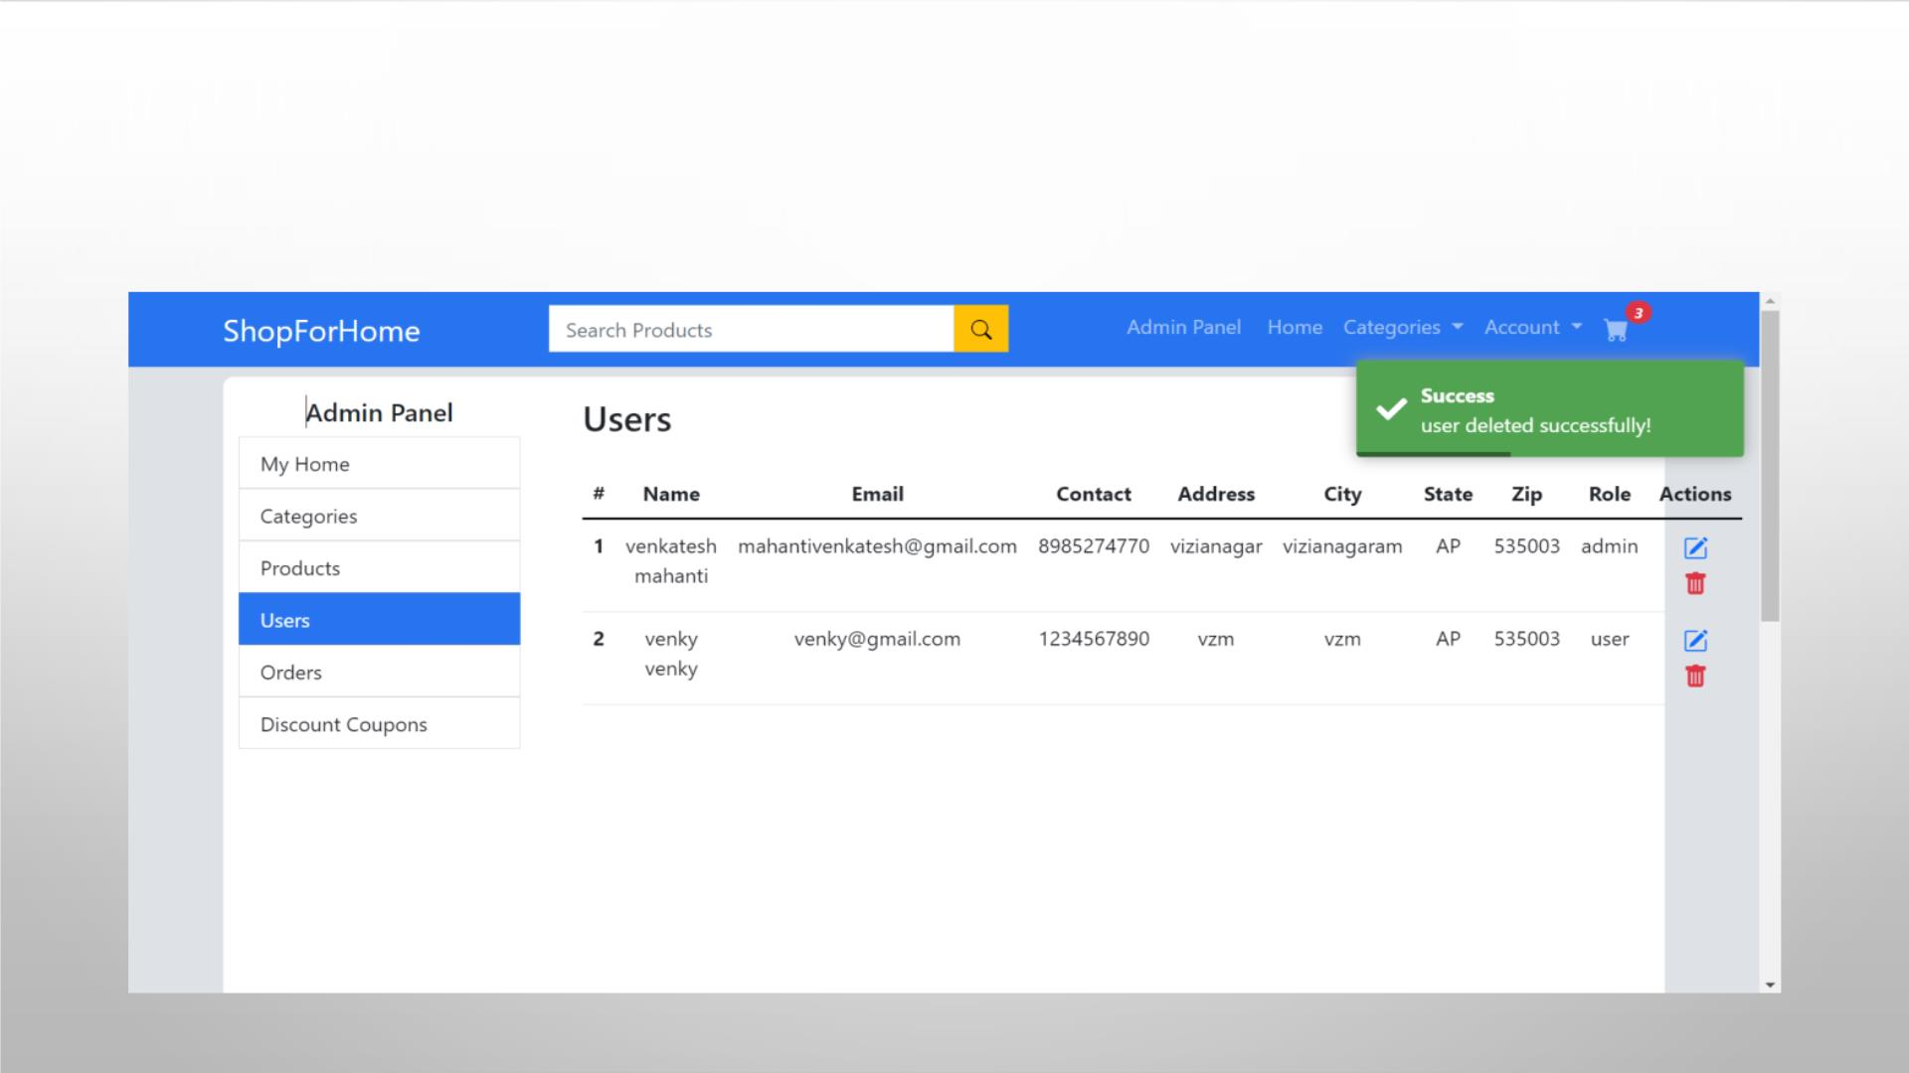
ADMIN CAN DELETE THE USER

Slide 49
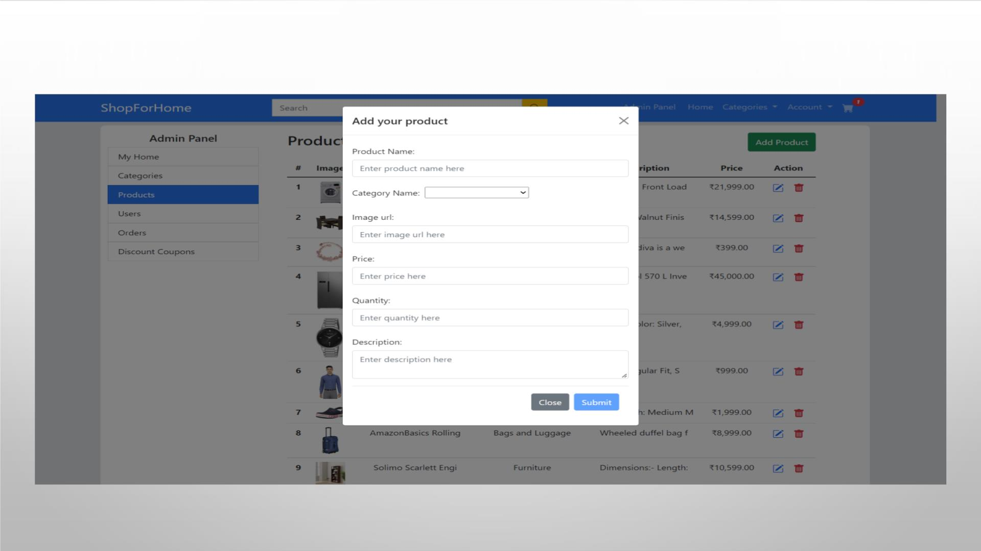
ADMIN CAN PERFORM CRUD ON PRODUCTS

Slide 50
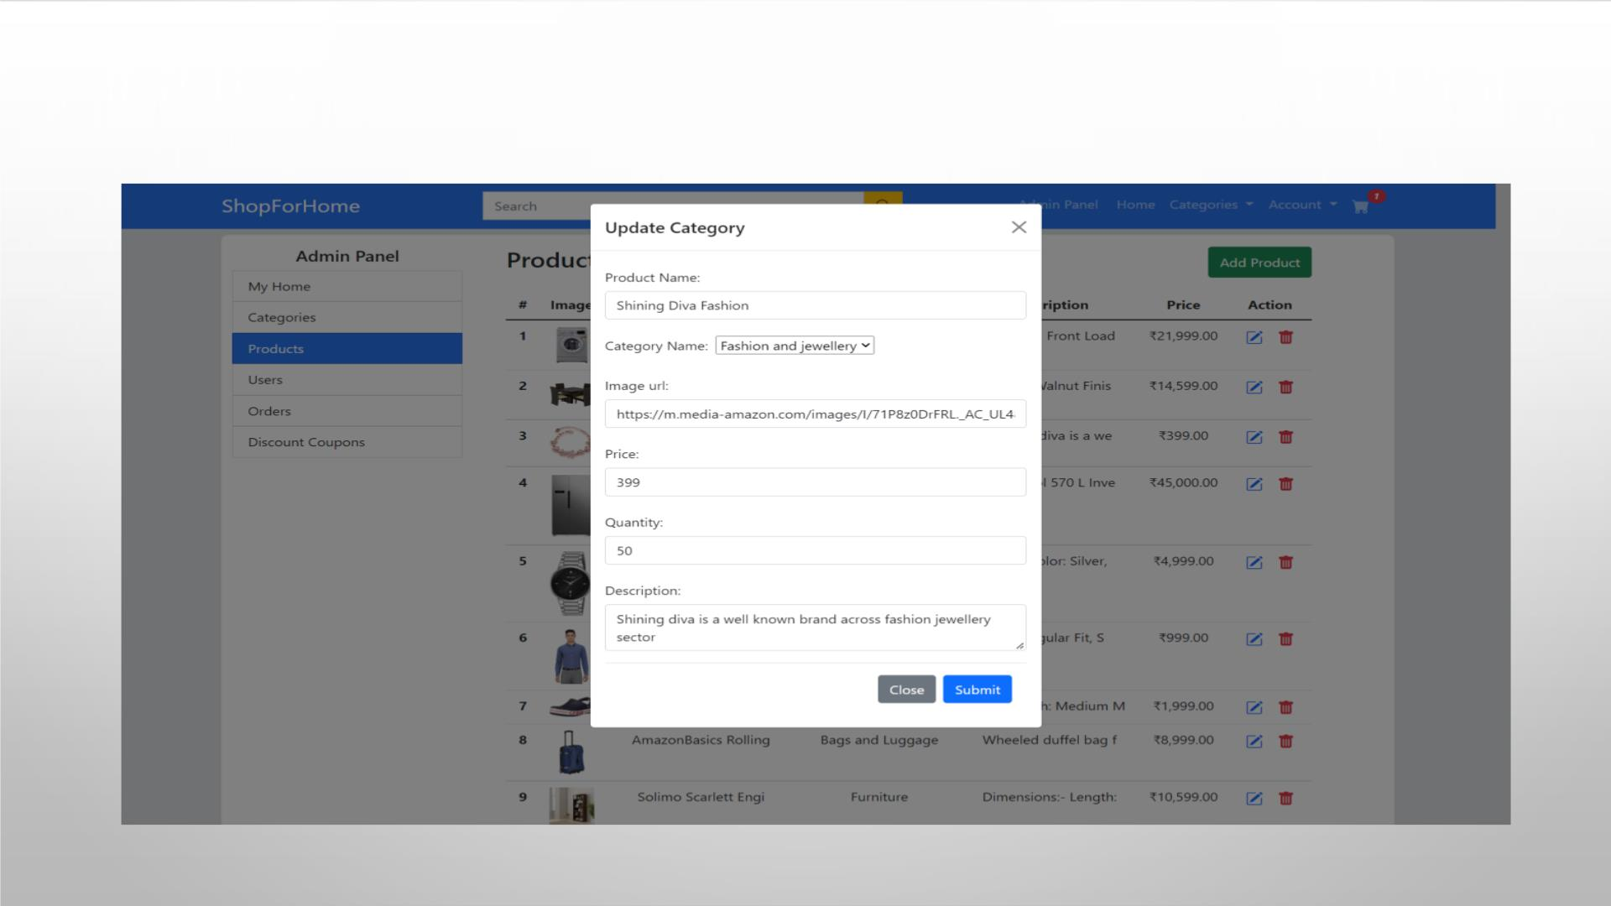
ADMIN CAN UPDATE THE PRODUCTS

Slide 51
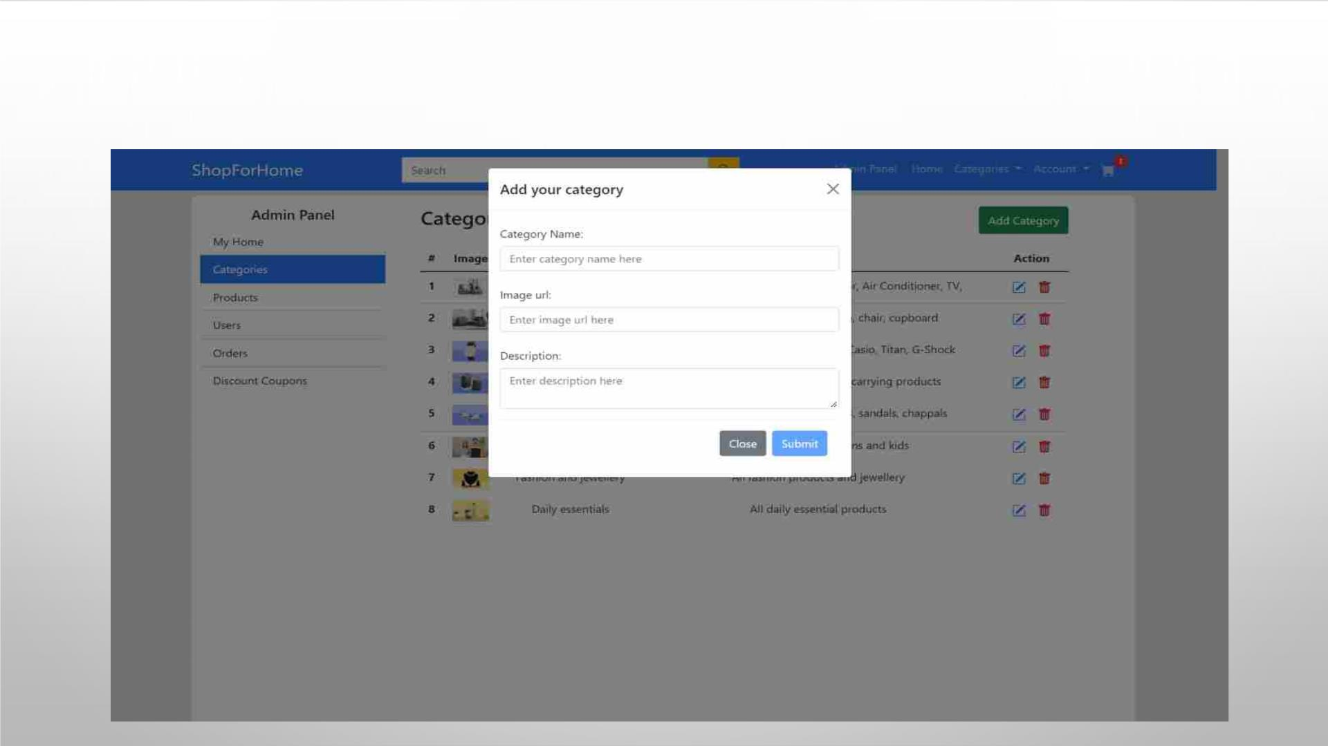
ADMIN CAN ADD CATEGORY

Slide 52
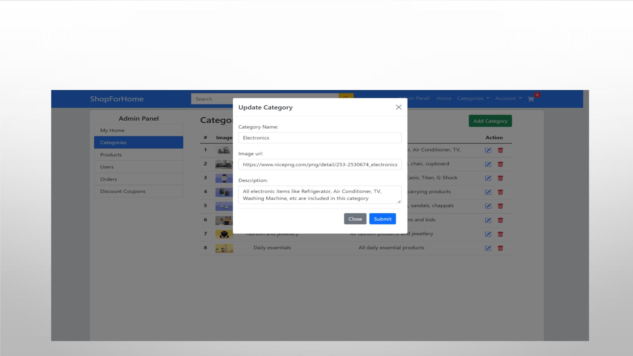
ADMIN CAN UPDATE CATEGORY

Slide 53
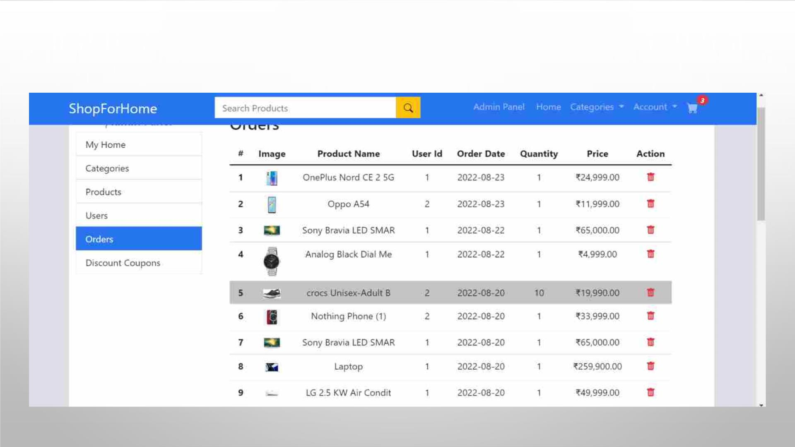
ADMIN CAN VIEW THE ORDERS

Slide 54
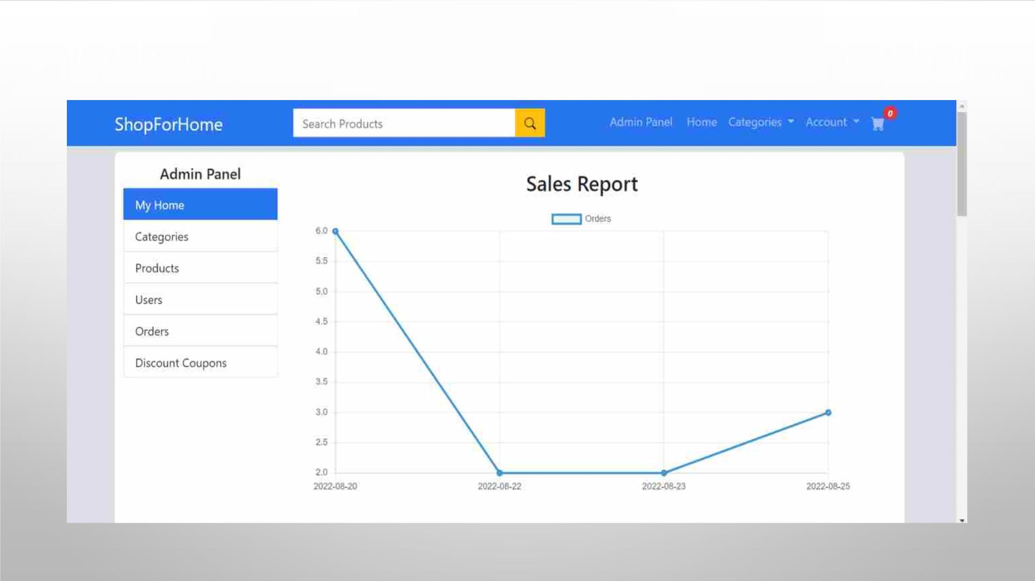
ADMIN CAN GET THE SALES REPORT

Slide 55
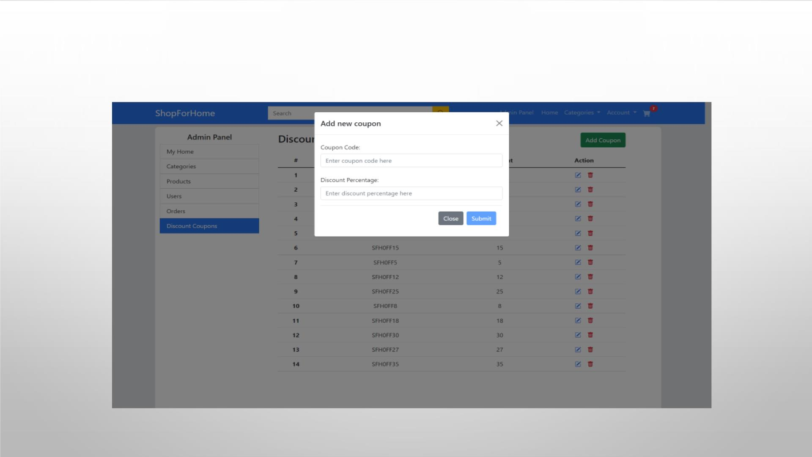
ADMIN CAN ADD DISCOUNT COUPONS

Slide 56
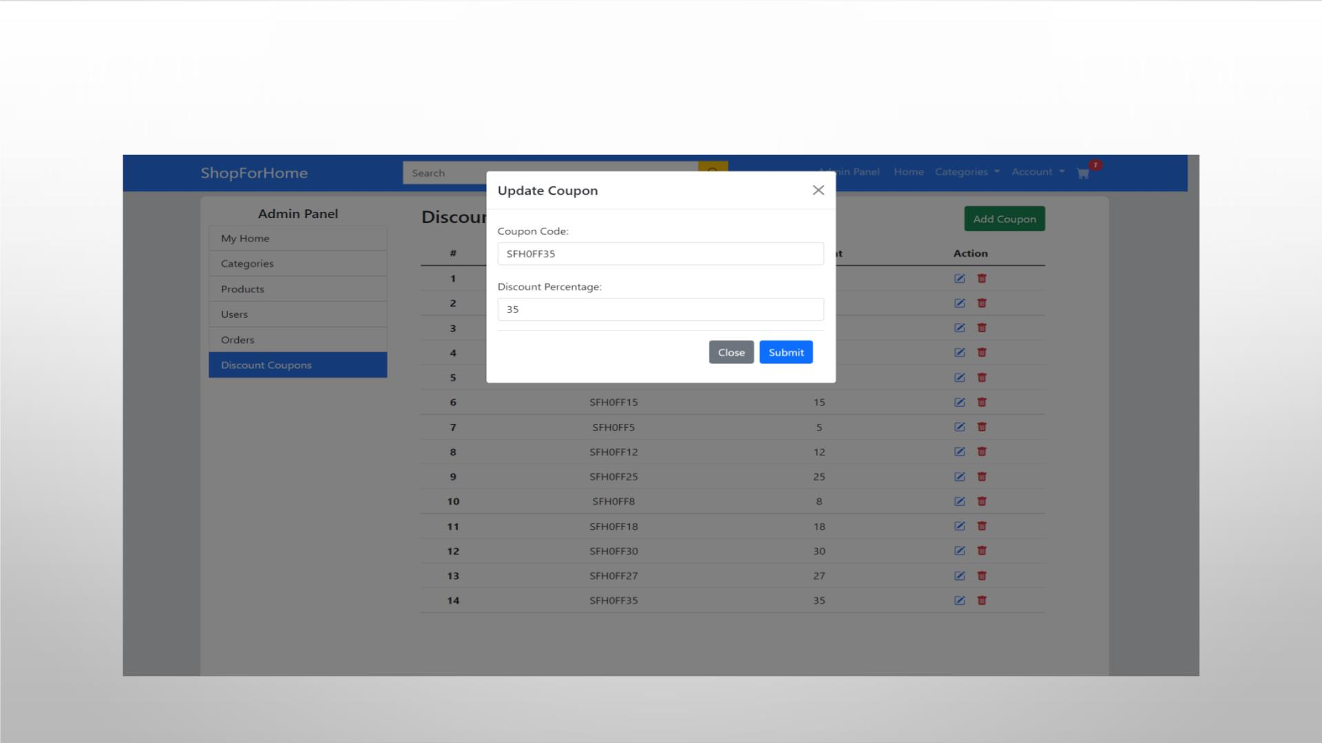
ADMIN CAN UPDATE DISCOUNT COUPONS

Slide 57
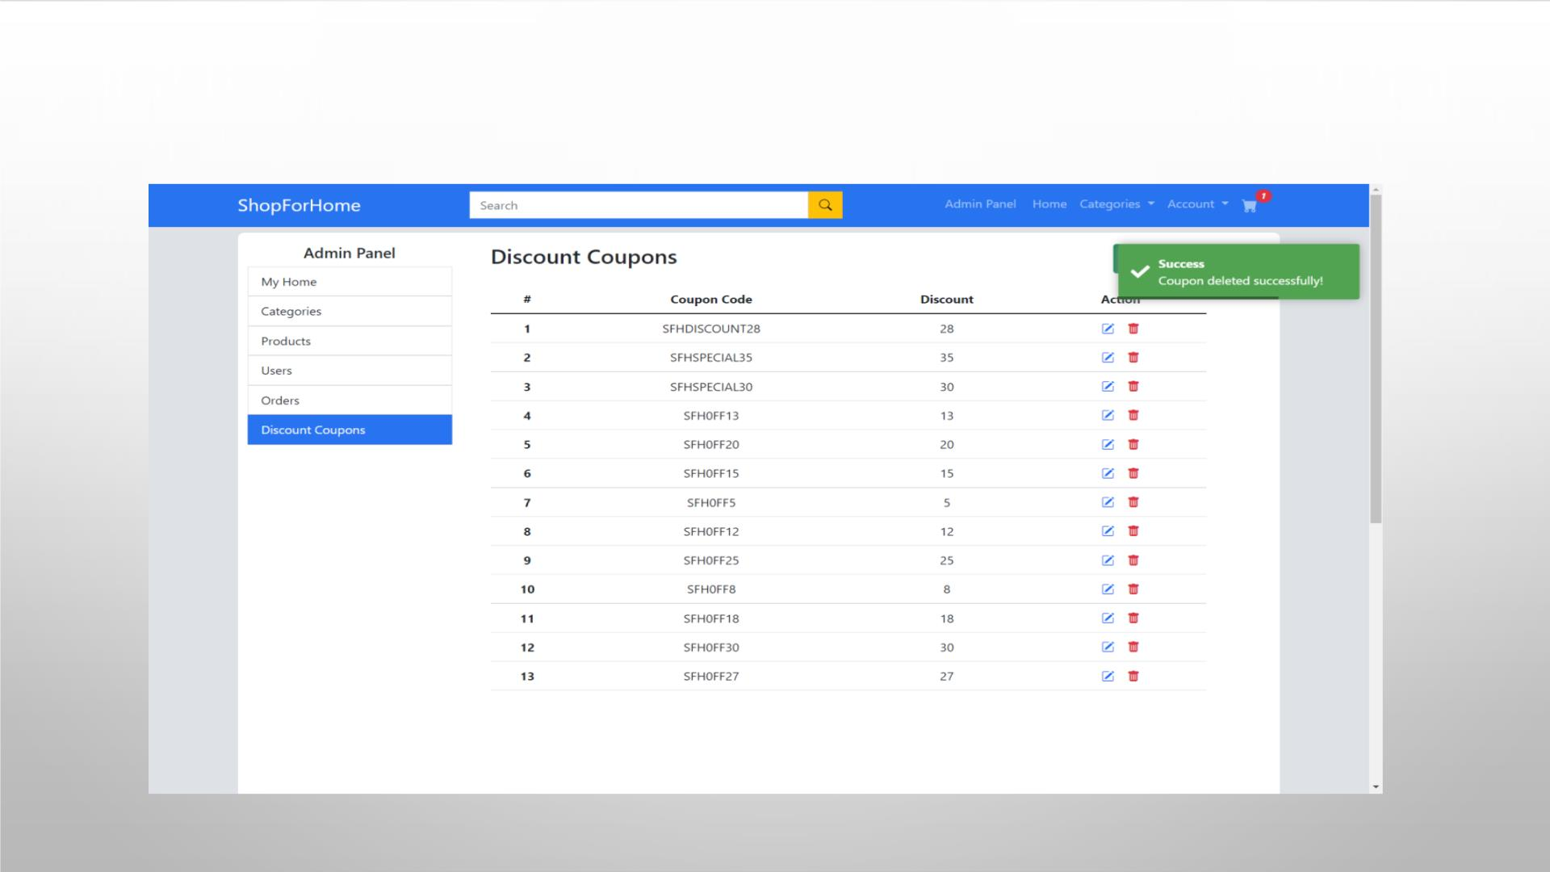
ADMIN CAN DELETE DISCOUNT COUPONS

Slide 58
CONCLUSION
ØTHE PROJECT HELPED US TO GAIN HANDS-ON PRACTICE OF THE CONCEPTS WE LEARNED IN
THE TRAINING.
Ø IN TRAINING WE LEARNED CONCEPTS LIKE CORE JAVA, HIBERNATE, SPRING CORE, SPRING
BOOT, CREATING RESTFUL SERVICES, HTML, CSS3, JAVASCRIPT, ANGULAR 14 AND APPLIED
THE THEORETICAL KNOWLEDGE INTO PRACTICAL APPLICATION.
Ø WHILE BUILDING THE PROJECTS WE FACED MULTIPLE CHALLENGES AND WE WERE ABLE TO
SOLVE THOSE CHALLENGES AND COMPLETED THE PROJECT. WE CAN FACE SIMILAR
CHALLENGES IN FUTURE , SO THIS EXPERIENCE WILL HELP US TO TACKLE SUCH
SITUATIONS.
Ø THE PROJECT HELPED US TO GAIN THE KNOWLEDGE AND SKILLS WHICH ARE REQUIRED TO
BE AN INDUSTRY READY ENGINEER.

Slide 59


